Slide 1
She Did What?
Student resource pack

Slide 2
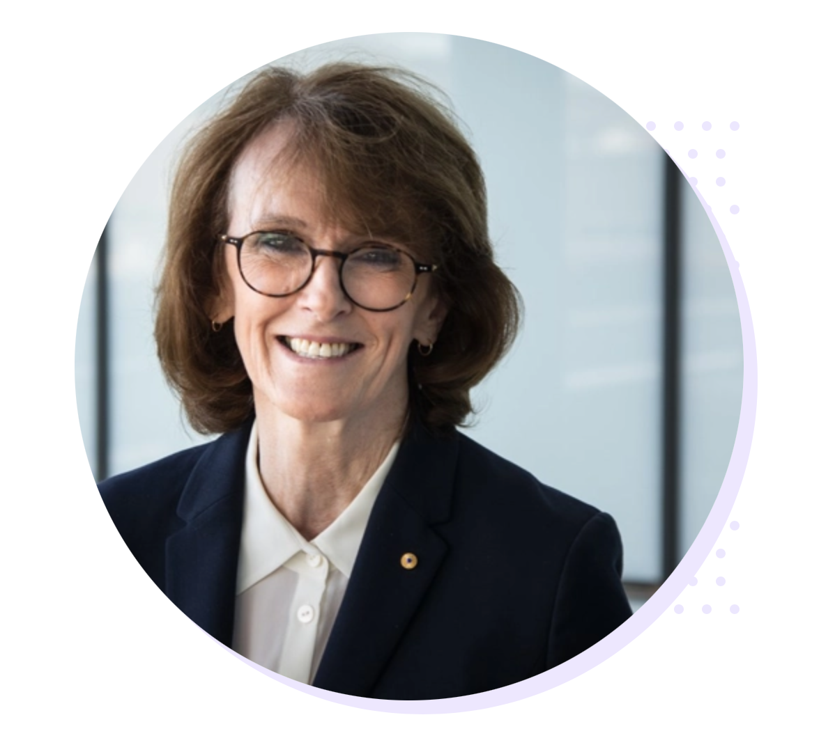
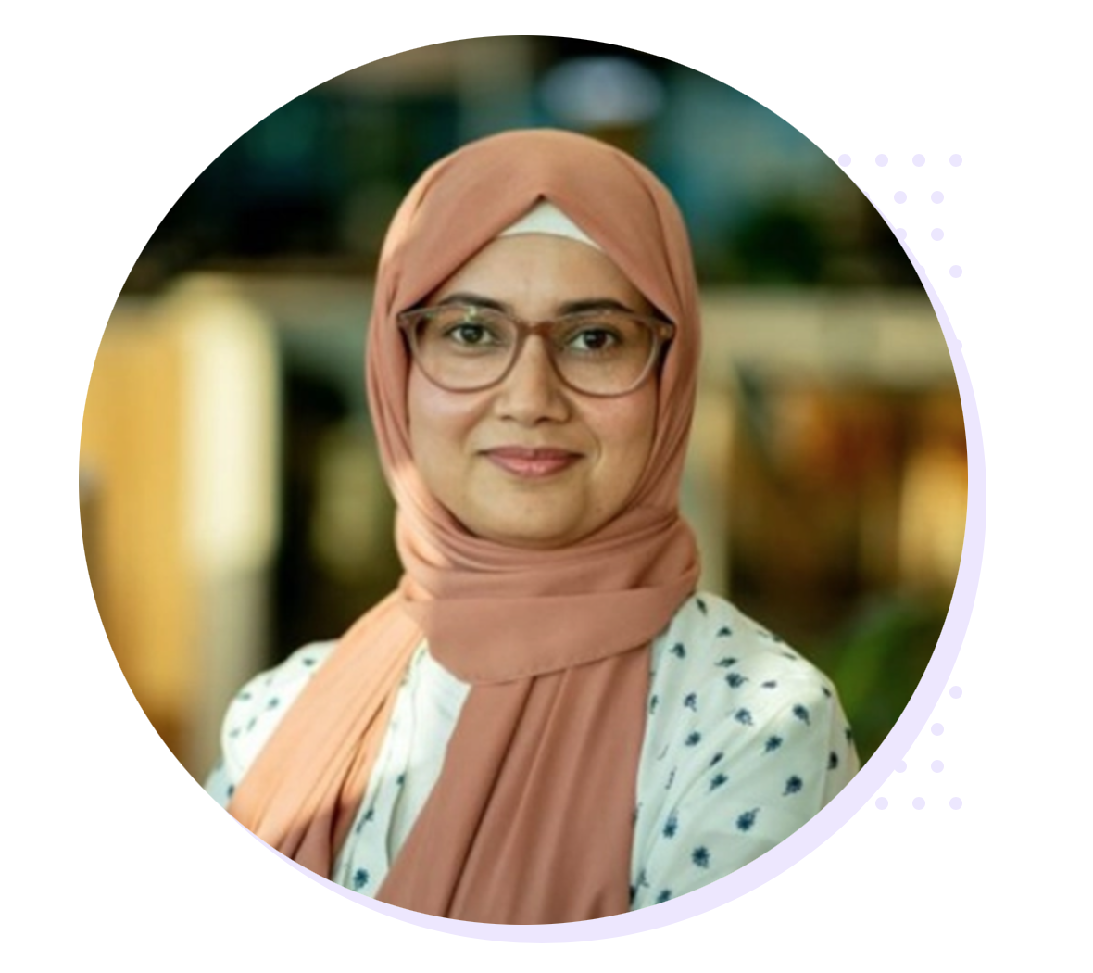
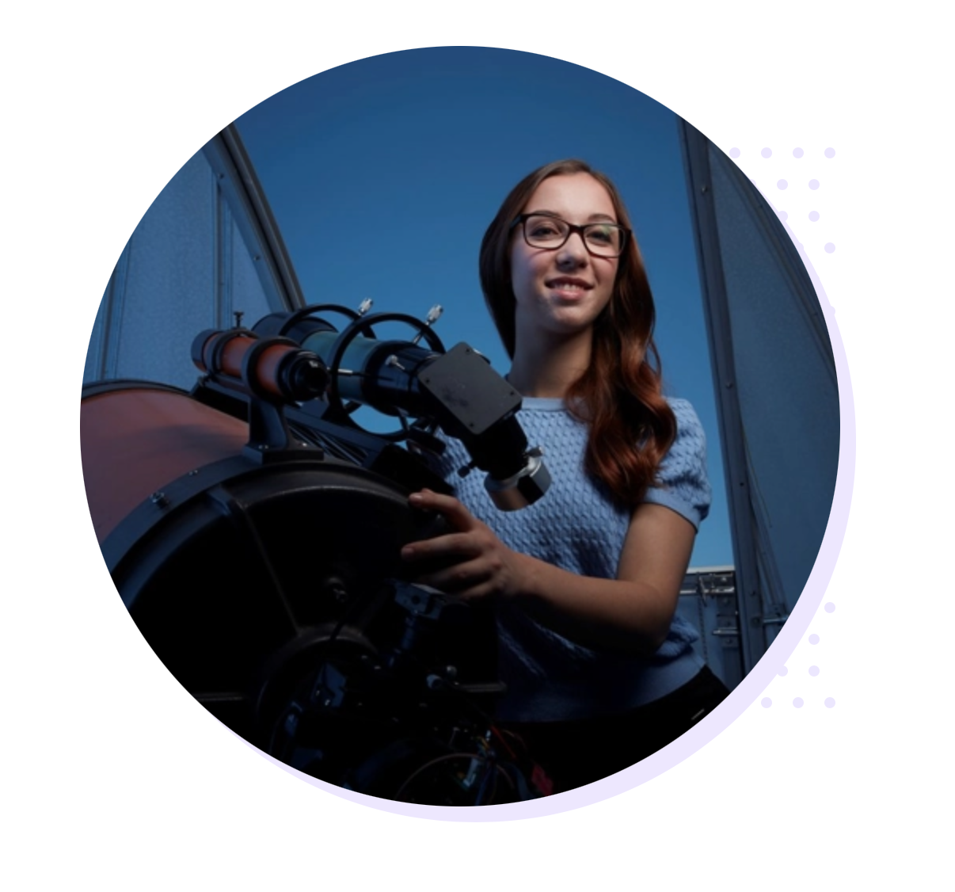
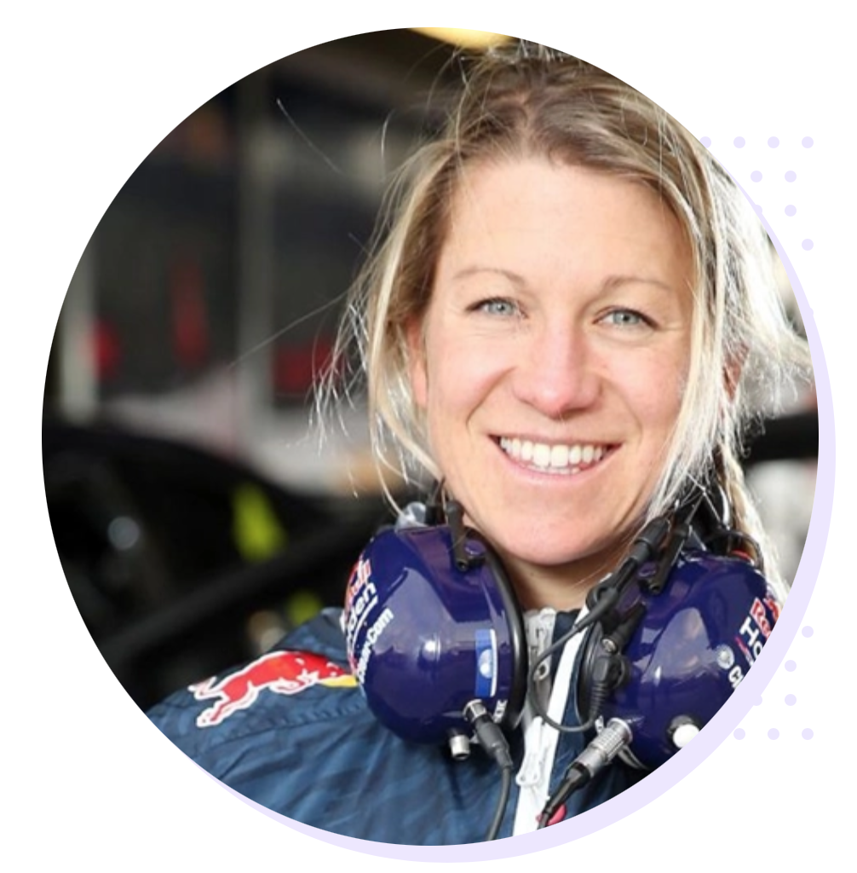
Match the STEM professional to her
achievement
Dr Cathy Foley
Dr Rashina Hoda
Kirstin Banks
Romy Mayer
Astrophysicist and
Science communicator
Leading researcher in human-centred AI software design
Australia’s Chief Scientist
Race car engineer

Slide 3
How did you go?
Dr Cathy Foley
Dr Rashina Hoda
Kirstin Banks
Romy Mayer
Australia’s Chief Scientist
Leading researcher in human-centred AI software design
Astrophysicist and
Science communicator
Race car engineer

Slide 4
The untold stories of women in STEM
Australian women are doing amazing, world-changing work in STEM
BUT their stories often go untold …
Quick poll:
Who can think of an amazing female Australian STEM expert – and describe what she achieved?
How did you go? If you couldn’t think of many women, you’re not alone.
Let’s change that!
Who inspires you? It’s time to share her story with the world.

Slide 5
Your task:
Create a 3-minute video outlining the accomplishments of an Australian woman in STEM.
Use your creativity and amazing production skills to make the video engaging for Australian students.
Publish/send your video and be in the running to win cash for you – and for your school!

Slide 6
Getting Started
1. Choose a STEM professional
One of the biggest challenges will be choosing a woman to focus on! Here are some ideas to get you started …
She went to your school
She invented something amazing that changed your life
She’s someone you know
She works at an institution near you
She won an award

Slide 7
STEM expert selection Q&A
Does she have to be famous? No. But maybe your profile will make her famous!
Does she have to be alive? No. You can profile any Australian woman.
Does she have to be born in Australia? No, she just needs to be living and working in Australia.
Does she have to be an academic? No, she just needs to be achieving in a STEM field – and that includes professions such as architecture, mining, defense, aeronautics and ecology.
What if we can’t decide? Why not shortlist some women and research to see who has a great story – then create that profile.

Slide 8
2. Research your STEM expert
You will need to find out …
Her story – what was her background? What were her aspirations? What led her to pursue her current career?
Her achievements – what did she do and why does it matter?
Note: Inspiration can be personal. Don’t be afraid to share why you personally find her story inspiring!

Slide 9
3. Plan your video design approach
How will you tell your story? You have lots of options.
Use still images, effects and a voiceover: https://youtu.be/Bgxp1sYdDOk
Use animation and voiceover: https://youtu.be/k02rionE5Xc
Use live action (this could be a direct interview or using actors): https://youtu.be/MZAEckUoE74
Use a combination of the above! https://youtu.be/fBbvGHY8cbo

Slide 10
4. Storyboard your video
Storyboard your video using the planner available on The GiST site
Get feedback
Refine your storyboard

Slide 11
5. Create your video
Create your visual and audio content
Use the PPT slides provided to create your opening title screen and closing credits
Get feedback
Edit your video

Slide 12
6. Check your final video
We have told the story of an amazing Australian STEM woman
The video is under 3 minutes (plus 10 seconds for title and 10 seconds for credits)
We have used the title and credit slides provided
The video is our own work and we have acknowledged all our sources
We have permission to share all images, video, music and/or voice content
We have protected our privacy
Our teacher/parent/carer has completed the competition declaration
7. Submit! Good luck!

Slide 13
<Your video title>
<Your school>

Slide 14
Credits
This video was produced by <student names, e.g. Therese H.>
We acknowledge the help and support of …
The following resources were used in this video:
<list all third-party images, video, music and sounds with appropriate copyright acknowledgement>

