Slide 1
The Girls in STEM Toolkit (GiST)
Talk Tools

Slide 2
The context
STEM Equity Monitor 2022
Notes:
Girls are increasingly on par with boys in achievement in STEM, but they are not pursuing STEM career pathways.

Slide 3
Barriers to STEM engagement
Fixed mindset
Gender stereotypes
Unconscious bias
Notes:
Girls and non-binary students face multiple issues when engaging with STEM subjects and careers. Some of those encountered during schooling include:
Fixed mindset
Gender stereotypes
Unconscious bias
Reflection question: What other barriers and issues do you see in your school or community?
Read more about these issues, and how find ways we can help alleviate these in our classrooms, on the GiST website.

Slide 4
The GiST approach
1. Create a gender-neutral learning environment
2. Engage in gender-inclusive teaching and learning
3. Actively support girls to develop positive STEM identities

Slide 5
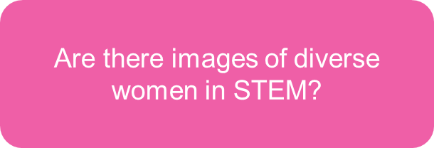
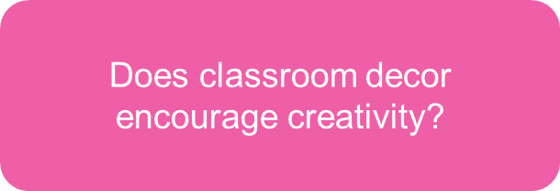
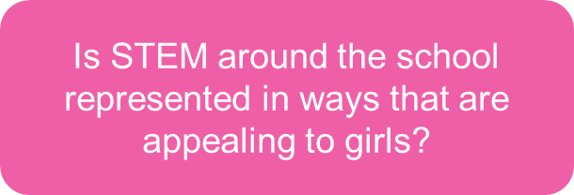
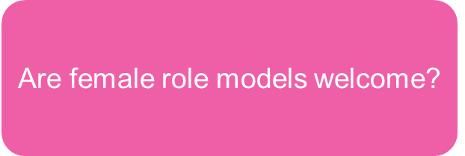
Create a gender-neutral learning environment
Notes:
By katemangostar on Freepik

Slide 6
Engage in gender-inclusive teaching and learning

Slide 7
Actively support girls to develop positive STEM identities
Identity relates to the way a person sees themselves as being interested or competent in an area, role or topic.
High achievement in STEM doesn’t always translate to a STEM identity.
Notes:
Activity – Explore your STEM identity
Part A: Think of someone who you would describe as a ‘STEM’ person and share the characteristics you believe make them so. As a group, explore the patterns in each other’s responses?
Part B: Do you consider yourself a STEM person? What has your STEM journey looked like?

Slide 8
GiST Talk Tools
Classroom talk is everything a teacher says in the classroom. What we say and how we say it – as well as who we invite to talk and how we listen – communicates our values and beliefs.
What we say
Experiences
What we believe and value
Unconscious biases
Beliefs
Knowledge

Slide 9
GiST Talk Tools
Classroom talk is everything a teacher says in the classroom – and this can be a powerful tool in promoting STEM. By tweaking our classroom talk we can actively develop girls’ STEM identities.
Foster STEM dispositions
Value students’ STEM knowledge and experiences
Explore diverse STEM experiences
Demonstrate transferable learning
Be interested and enthusiastic

Slide 10
1. Show interest and enthusiasm
Notes:
Girls may have the idea that ‘getting it right’ is all that matters. This creates a need to refocus instead on the diverse range of dispositions and skills that are pivotal to STEM.
Focus on the importance of naming dispositions and skills so that students create a positive self-image of themselves doing STEM.

Slide 11
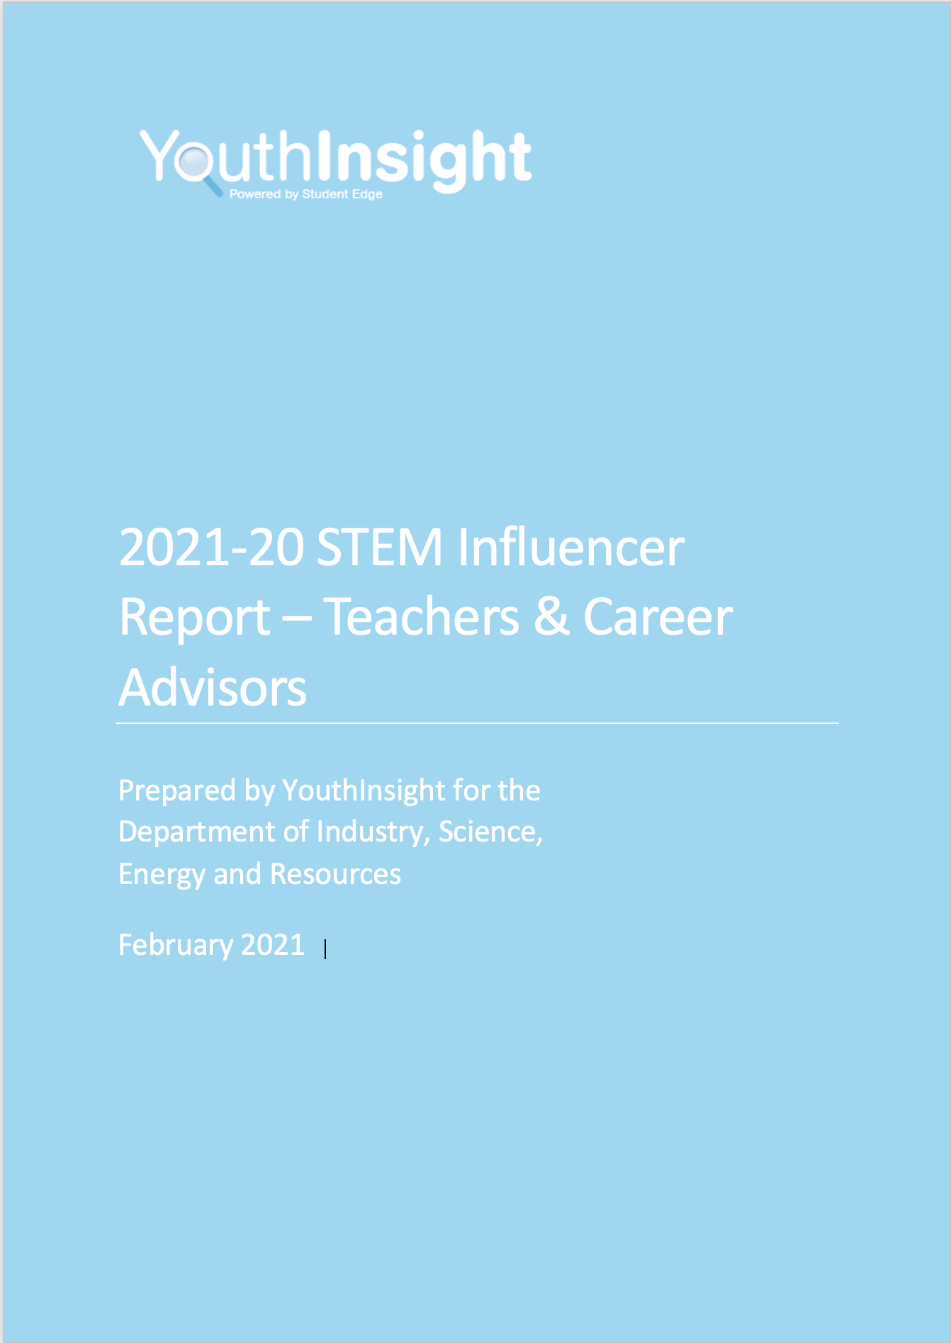
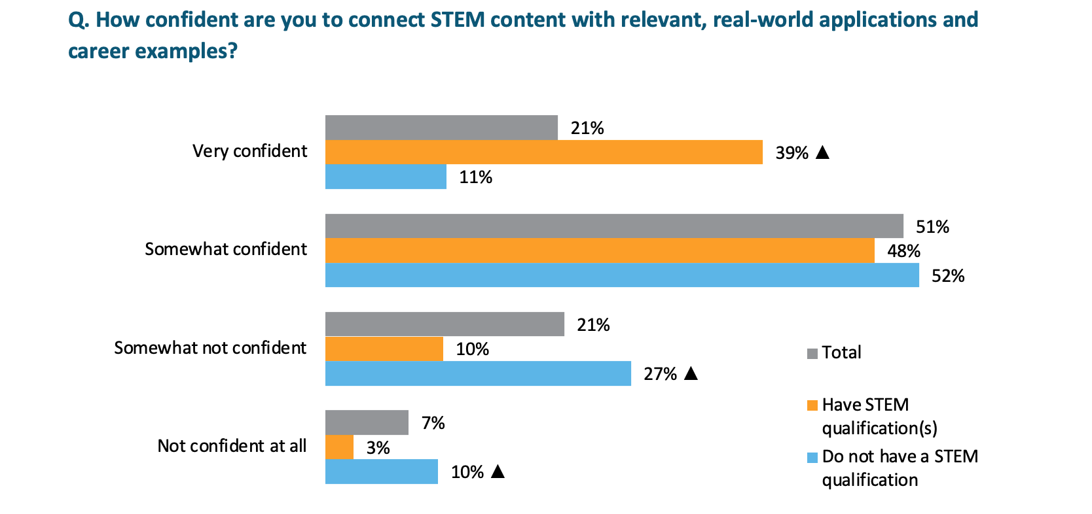
Students are more likely to be positively engaged in STEM if you are genuinely* interested and enthusiastic.
*Students can tell when you’re faking enthusiasm – and it doesn’t have the same effect!
Notes:
One of the challenges associated with developing genuine interest and enthusiasm is that many educators don’t have a STEM background. According to the YouthInsight STEM Influencer Report (2021), teachers with prior qualifications are nearly four times as likely to feel confident connecting STEM content with real-world applications than those who do not have prior STEM qualifications.
Workshop activity:
Hold an anonymous poll to find out how teachers rate their personal interest and enthusiasm for each of science (physics, chemistry, biology, earth and environmental science), technology, engineering and mathematics.

Slide 12
What brings STEM alive for you?
G
E
H
AL
SN
SL
Notes:
Workshop activity:
Try some Trivial Pursuit to get you thinking about STEM connections. The answer to each of these questions is something to do with chemistry. Can you devise a question for each category?
You could share the questions below as an example, to get people thinking, then hand out blank cards for students to create their own.
Geography - Why can you float in the Dead Sea? (High salinity means your body is less dense than the water)
Entertainment - What is the name of the book by Bonnie Garmus that has been made into a series starring Brie Larson? (Lessons in Chemistry)
History - Who is the only woman to have won the Nobel Prize twice? (Marie Curie, once for Physics and once for Chemistry)
Art and Literature - Why was the Hatter in Alice in Wonderland depicted as mad? (Mercury poisoning)
Science and Nature - What type of acid is released by an ant when it bites? (Formic acid)
Sport and Leisure - What chemical element is used to inflate most balloons that float? (Helium)
Try this activity when planning units of work to find a wide range of ways ‘into’ the content. You don’t have to use all the avenues, but if one grabs your interest, run with it!

Slide 13
Show interest and enthusiasm
Express your own authentic rationale for learning the topic.
Share what interests you, makes you wonder and want to learn more.
Share personal stories that relate to STEM, including your own fears or anxieties.
Encourage students to share ideas and explore concepts.
When a debate takes you out of your comfort zone, acknowledge this and let the discussion continue.
Recognise and celebrate others’ passion for the topic.
Actively break down stereotypes of the types of people who do STEM.
Notes:
Express your own authentic rationale for learning the topic. Avoid justifying the topic with reference to the curriculum or exit requirements.
Share what interests you, makes you wonder and want to learn more.
Share personal stories that relate to STEM, including your own fears or anxieties. Use sharing your negative experiences as an opportunity to show that feelings and attitudes aren’t fixed, modelling a growth mindset.
Encourage students to share ideas and explore concepts. Ask students to justify their opinions and acknowledge when further research is required.
When a debate takes you out of your comfort zone, acknowledge this and let the discussion continue – model learning with your students.
Recognise and celebrate others’ passion for the topic. Actively break down stereotypes of the types of people who do STEM.

Slide 14
2. Foster STEM dispositions
Notes:
Girls may have the idea that ‘getting it right’ is all that matters. This creates a need to refocus instead on the diverse range of dispositions and skills that are pivotal to STEM.
Focus on the importance of naming dispositions and skills so that students create a positive self-image of themselves doing STEM.

Slide 15
Notice dispositions and skills
Model curiosity by wondering out loud
Value and reward student contributions that demonstrate curiosity, scepticism, creativity and intellectual risk-taking
Link students’ dispositions to thinking like a STEM practitioner
Actively embrace and celebrate confusion and disagreements
Notice and acknowledge perseverance and effort in reasoning and sense-making
Explicitly teach students how to respectfully disagree
Model and explicitly teach students how to ask questions to understand another person’s perspective
Notes:
Model curiosity by wondering out loud about phenomena or ideas.
Broaden students’ ideas about what counts in STEM, by valuing and rewarding not just right answers, but student contributions that demonstrate curiosity, scepticism, creativity and intellectual risk-taking.
Link students’ dispositions to thinking like a relevant STEM practitioner, for example, ‘What a great thing to wonder about, Sam! I love your curiosity; you’re really thinking like an engineer.’
Actively embrace and celebrate confusion and disagreements as crucial moments in learning, for example, ‘I see that we have a range of ideas about what’s happening here. Excellent! Let’s work through these different perspectives to build our understanding.’
Talk about failure and setbacks when they occur, honouring the emotions associated with struggle, and the value of persistence in the face of obstacles.
Notice and acknowledge perseverance and effort in reasoning and sense-making rather than just the outcome, for example, ‘Lisa, I can see all the different ways you’ve tried to solve this and the way you’ve connected these ideas. That shows fantastic thinking and persistence.’
Explicitly teach students how to respectfully disagree, for example, by modelling sentence stems, such as ‘I respectfully disagree with … because I think …’ or ‘I like your ideas, but…’
Model and explicitly teach students how to ask questions to understand another person’s perspective, for example, ‘Can you tell me more about …?’ , ‘What do you mean by …?’ or ‘Could you please explain …?

Slide 16
3. Value students’ STEM knowledge and experiences
Notes:
Students with different cultural capital can feel left out. It is important to show that students already have significant STEM capital, even if they don’t recognise it as such, and avoid unconsciously promoting intersectional disadvantage.
Workshop activity:
Set up a card game with student interest profiles + curriculum focus areas. The challenge is to find the link between student interests and curriculum focus areas.

Slide 17
Elicit student knowledge and experiences
Invite and value student contributions drawn from their experiences outside of school
Share relevant examples from your own personal life experiences
Ensure all students have opportunities to contribute in ways they feel comfortable
Highlight the STEM nature of different sorts of contributions
Provide examples of different types of people who work in STEM-related job
Ask students to provide examples of topics through media, family experiences or their knowledge outside of school
Notes:
Invite and value student contributions drawn from their experiences outside of school, for example, ‘Megan, your aunt is into rewilding, isn’t she? Can you explain how you go about restoring habitat?’
Share relevant examples from your own personal life experiences as a model, for example, ‘I became interested in probability when I was researching computer models of rainforests, trying to work out what size rainforest would be required to be sustainable.’
Ensure all students have opportunities to contribute in ways they feel comfortable, for example, ‘Preemi, I wonder if you could share a screen capture of your latest computer game in action? I think it will show us how you can use a physics engine to create an immersive experience.’
Highlight the STEM nature of different sorts of contributions, for example, ‘Ruani’s description of her reactions when she’s playing tennis really illustrates the impact of adrenaline on the body system.’
Provide examples of different types of people who work in STEM-related jobs to elicit stories about friends or families, for example, ‘My friend George is a vet nurse, and they use ratios all the time to work out how much medication to give each pet.’
Ask students to provide examples of topics as they emerge through the media, family experiences or their knowledge outside of school, for example, ‘Has anyone seen any films that showcase new materials with special properties?’

Slide 18
4. Explore diverse STEM experiences
Notes:
Students with different cultural capital can feel left out. It is important to show that students already have significant STEM capital, even if they don’t recognise it as such, and avoid unconsciously promoting intersectional disadvantage.
Workshop activity:
Set up a card game with student interest profiles + curriculum focus areas. The challenge is to find the link between student interests and curriculum focus areas.

Slide 19
Bias and stereotypes
Everyone struggles – don’t feel ashamed, don’t give up!
Impostor syndrome
Everyone feels anxiety, loneliness, confusion and self-doubt at times
Feeling like you don’t belong
Failure is not indicative of character
Form communities with others
Find a role model or mentor
Feel empowered and persist
Notes:
Explore some of the key issues (in blue) and counteract with the idea that these experiences are not limited to school STEM; these may be experienced in many different careers.
Explore the ideas outlined in grey. These can be shared by STEM professionals exploring experiences of undergraduate women in STEM. Focus on the fact that failure happens and is an important part of experimenting to find solutions. Normalise these feelings so that we can continue to look for solutions.
Reference the Matilda effect, and reference intersectional effects.
Explore how to interview someone to understand the diversity of their experience, not just the ‘good news story’.
Read this article where women in STEM provided advice to STEM undergraduates: https://stemeducationjournal.springeropen.com/articles/10.1186/s40594-023-00411-0

Slide 20
Explore the diversity of STEM experience
Value students’ recounts of their own, family members’ or friends’ challenging STEM experiences
Invite STEM role models from your community to talk to students about their experiences
Model wondering about the lived experiences of STEM role models
Model wondering about representations of STEM in the media
Notes:
Value students’ recounts of their own, family members’ or friends’ challenging STEM experiences, supporting the class to appreciate the range of experiences.
Invite STEM role models from your community to talk to students about their experiences, how they overcame barriers and why they persisted, and encourage students to ask questions.
Model wondering about the lived experiences of STEM role models, for example, ‘I wonder how it felt to be a woman in a workplace that was predominantly male?’
Model wondering about representations of STEM in the media, for example, ‘Do you think that’s an accurate representation of the diversity of STEM practitioners? I wonder how it would feel not to be represented there.’

Slide 21
5. Demonstrate transferable learning
Notes:
Possible activity: Take students on a guided tour of new Australian Curriculum website highlighting parallel skills across all the learning areas.

Slide 22
Demonstrate transferability of STEM
Make explicit connections between STEM knowledges when teaching other learning areas, and vice versa
Reflect on productive struggle in another learning area and compare the experience to students’ STEM challenges
Leverage students’ strengths in other learning areas to build their STEM dispositions and skills
Notes:
Make explicit connections between STEM knowledges when teaching other learning areas, and vice versa, for example, ‘Remember when we worked on procedural texts in English and you had to break down the process into specific steps? That’s a similar type of thinking we use when we’re developing algorithms in Digital Technologies.’
Reflect on productive struggle in another learning area and compare the experience to students’ STEM challenges, for example, ‘Amara, you couldn’t do a cartwheel at the beginning of the year, but now you can. How were you able to develop that skill?’
Leverage students’ strengths in other learning areas to build their STEM dispositions and skills, for example, ‘Luisa, the way you thought about the text from each character’s perspective yesterday was so insightful. As you design your solution, I wonder if you can use that same empathy to think about different users’ needs?’

