Slide 1
Notes:
40 min end 12.30

Slide 2
‘Over 80% of employees agree that STEM qualifications are valuable to their workplace.’
—Australia’s STEM workforce. (2014). Deloitte Access Economics
Image credit: Kirsten Gottschalk
Notes:
What is STEM?
STEM stands for science, technology, engineering and maths.
What are the benefits of STEM?
STEM qualifications are highly valued by employers.
STEM graduates are much more likely to gain full-time employment compared with the national average for graduates.

Slide 3
Benefits for students
Over 80%
of science, technologies and maths graduates gain full-time employment compared with the national average of 72.9%.
Over 88%
of engineering graduates gain full-time employment
A STEM degree can be a starting point for virtually any career
2018 Graduate outcomes survey
2018 Graduate outcomes survey
Notes:
Benefits for students
A STEM degree can be a starting point for virtually any career.
Over 80% of science, technologies and maths graduates gain full-time employment.
Over 88% of engineering graduates gain full-time employment.

Slide 4
Benefits for everyone
GDP would rise by
$57.4 million
if just 1% of Australia’s workforce changed into STEM roles
Advanced sciences underpin
15-22%
of Australia’s economic activity
STEM and its products impact almost everything we do.
PricewaterhouseCoopers
Australian’s STEM workforce report
Notes:
Affect on GDP
Economic growth is driven by science, engineering and technological innovation.
PricewaterhouseCoopers estimated that if just 1% of Australia’s workforce changed to STEM roles, GDP would rise by $57.4 million.
Engaging girls
Vital for Australia to keep up by having a STEM-qualified workforce.
Yet half of Australia’s population has been missing out on STEM opportunities.

Slide 5
Youth Insight surveyed 2092 students across Australia between December 2018 and January 2019. The findings were weighted to balance gender and age. ‘Students’ refers to people currently studying between the ages of 12 and 25. The data in this graphic comes from the Youth Insight Report.
Notes:
Girls in STEM
Despite employer demand, only 32% of girls choose elective STEM subjects in years 9/10 compared with 70% of boys.
And fewer Australian girls undertake Year 12 STEM subjects than boys.

Slide 6
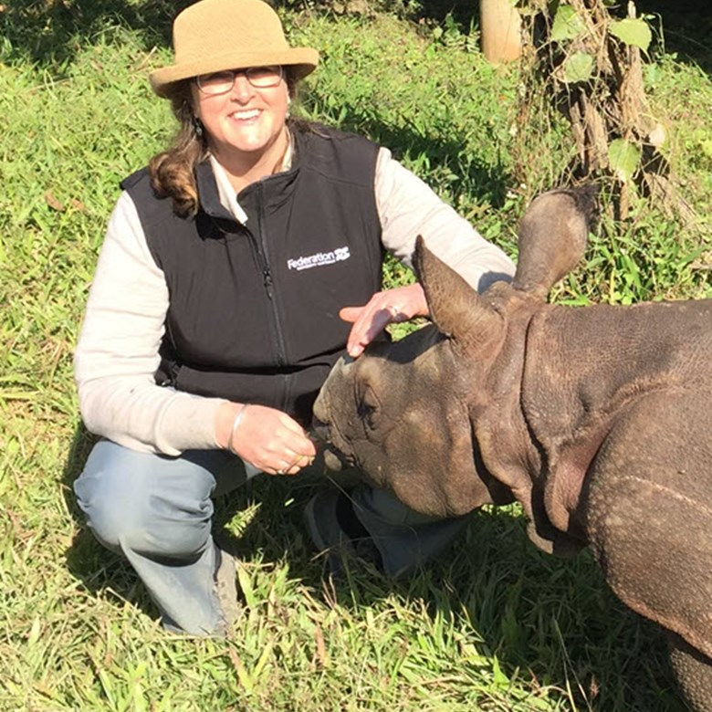
‘Women make up only 16 per cent of the STEM skilled workforce’
—Women in STEM Decadal Plan. (2019). Australian Academy of Science
Image credit: Wendy Wright
Notes:
Women make up only 16% of the STEM-skilled workforce
So how can we engage girls in STEM? How can families play a part?

Slide 7
Notes:
Young Australians have positive attitudes towards STEM
4 out of 5 agree that ‘scientists make a positive impact on the world’.
64% say that learning about science and technology is exciting.
Most see STEM skills as important for getting jobs.
54% say that families have a big influence on their subject choices.

Slide 8
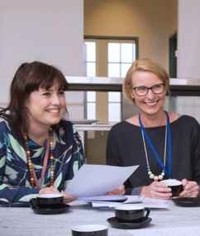
Influences on girls
Family
Schools and teachers
Media
Peers
Image of Dana Scully: Film Company 20th Century Fox. AF archive/Alamy Stock Photo
Notes:
How do girls form their attitudes and opinions about STEM? Family
Family has the greatest influence. The Microsoft Closing the STEM Gap report found that girls who are encouraged by their parents are much more likely to pursue STEM subjects and pathways than girls who aren’t. Interestingly, while encouragement from mothers was important, they found that encouragement from fathers had a slightly greater impact.
Media
Media makes a difference. And it’s not always negative. ‘The Scully Effect’ – there was a massive increase in women achieving Bachelor’s degrees in STEM fields in the 1990s – and this is often linked to the influence of X-Files character Dana Scully, a medical doctor recruited by the FBI as a forensic pathologist, with an undergraduate degree in physics.
Peers
Peers are particularly important to adolescent girls, whose desire to ’fit in’ and be socially accepted can overwhelm their personal interests and passions.
Teachers and schools
Although they have less of a direct influence on student choices, teachers and schools can play a particularly important role in challenging dominant stereotypes and providing access to role models.
This presentation will focus on the influence of families, and what families can do to make a difference.

Slide 9
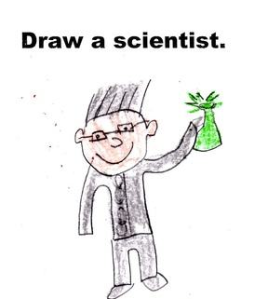
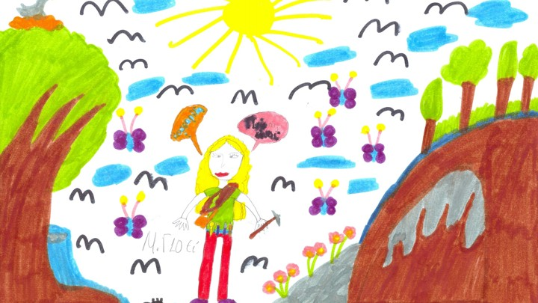
Perceptions
SIKRIT STUFF FOR SIKRIT
ENVINSHUNS—SIKRIT
Source: Crestwood explores the world
Source: The Atlantic
Notes:
Between 1966 and 1977 kids were asked to draw scientists and most drew someone like this.
In the original test, out of nearly 5000 students tested, only 28 girls and no boys drew female scientists.
Over time the Draw-a-Scientist Test became a well-known piece of social science. David Miller of Northwestern Uni continues further analysis.
From the 1980s onwards, on average, 28 per cent of children drew female scientists, compared to 0.6 percent in Chambers’s original study.

Slide 10
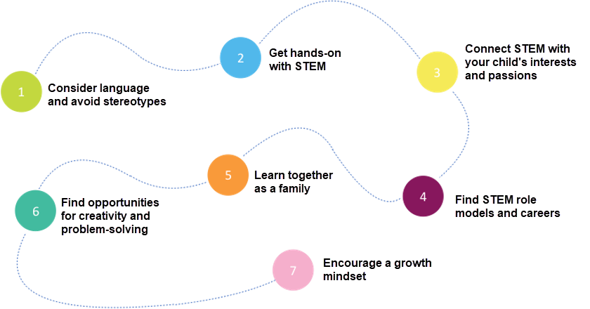
7 things that families can do
Notes:
Families can help build girls’ confidence and interest in STEM at home, using these 7 steps.

Slide 11
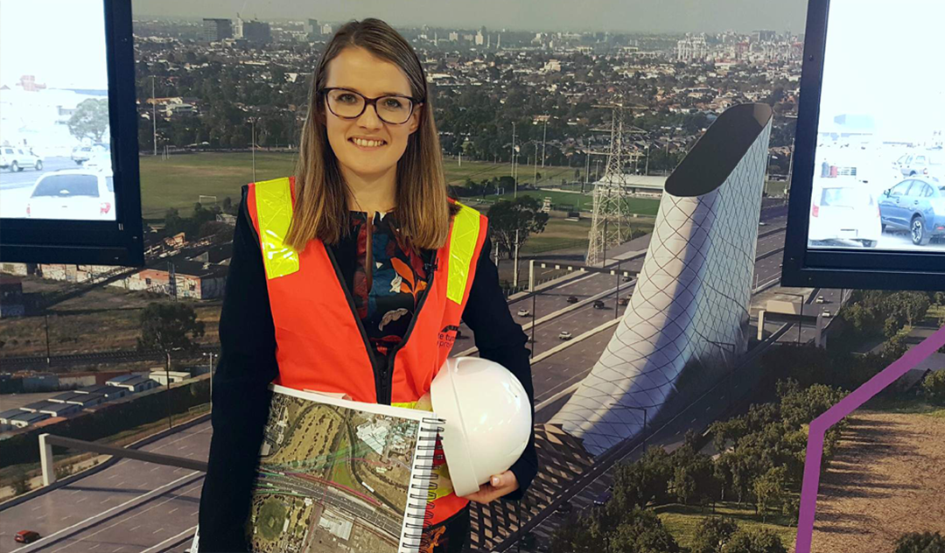
1. Consider language and avoid stereotypes
When the family talks about people in STEM careers, try to notice and counter gender stereotypes and biases.
Image credit: Felicity Furey
Notes:
To understand how families can make a difference, it’s important to understand the role that girls’ self-concept plays in shaping their attitudes to STEM.
Girls’ interests and aspirations frequently don’t align with how STEM is portrayed by family, friends, teachers and the media.

Slide 12
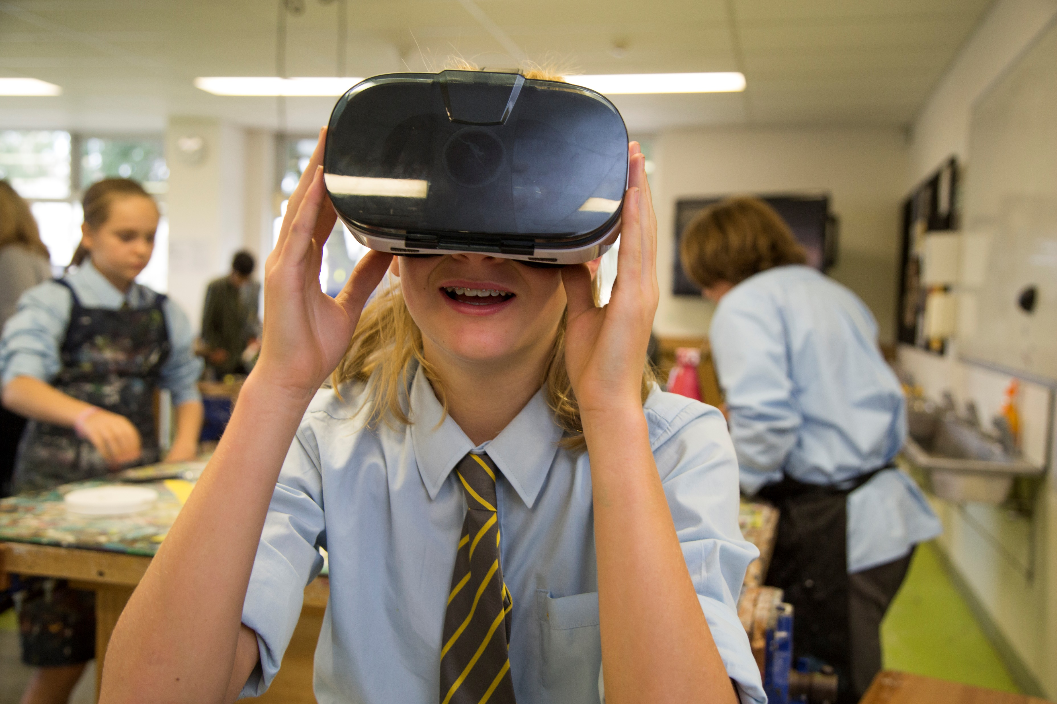
2. Get hands-on with STEM
Give girls opportunities to get hands-on with STEM.
In particular, encourage girls to develop their spatial skills and use computers and other equipment.
Notes:
Girls benefit from hands-on and inquiry-based learning.
Girls may not have spent as much time playing with construction-based toys, and may feel they lack natural ability.
Actually, research indicates that anyone can improve their skills with spatial training.
Spatial skills are key to success in many STEM endeavours. A 2017 study commissioned by Microsoft found that the more practical experiences a girl receives during her education, the higher her interest in STEM.

Slide 13
3. Connect STEM with your child’s interests and passions
Connect girls’ interests and passions to STEM subjects and careers.
Find links between STEM and issues, problems and topics that your child finds personally meaningful.
Image credit: Sabrina Fossette
Notes:
Girls often want to perceive themselves as collaborative, caring, creative, and socially and environmentally conscious.
Research shows that girls’ perception of a subject’s relevance affects their attitudes towards that subject.
Many girls are interested in ‘helping’ careers, so contexts that demonstrate how STEM can be helpful and make a difference in the world are particularly valuable.
Context-based learning also provides an opportunity to provide a strong link between school experiences and STEM careers.

Slide 14
4. Find STEM role models and careers
Girls who see role models in STEM who look like them are more interested and confident about pursuing STEM careers themselves.
Image credits: Angelina Arora; Jesse May Licot; Marlee Hutton; Kellee Reissinger
Notes:
Role models
Role models reduce stereotypic beliefs and increase engagement with STEM.
Research has shown that when girls are exposed to positive STEM role models who look like them, their interest increases, along with an improved self-concept related to STEM fields.
Role models should share girls’ interests and activities outside of their STEM-related activities. And it’s even better if descriptions of their current roles connect back to school experiences.
Sometimes it is difficult to find women in science history. Even recent history: In October 2018, when Donna Strickland won a Nobel Prize in physics, numerous write-ups mentioned that she did not previously have a Wikipedia page. A draft had been submitted, but was rejected for not demonstrating ‘significant coverage (not just passing mentions) about the subject’.
Diversity is important - motivation by association.
The GiST provides examples of great role models, and also how to connect to programs like STEM Professionals in Schools.
Careers
Link careers to areas of study.
Describe careers by providing the ‘person spec’ as well as the ‘job spec’. The UK Not for People Like Me report advises emphasising to girls that STEM careers are for people like them.

Slide 15
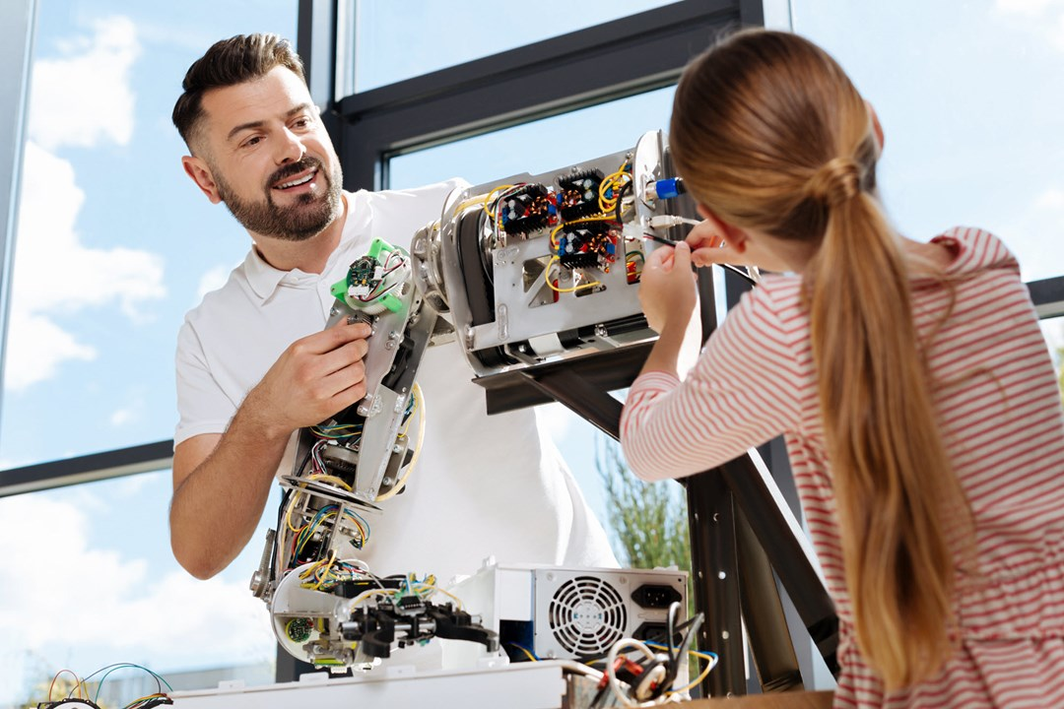
5. Learn together as a family
Many girls enjoy collaborating and learning with other people. Can you think of ways to learn about STEM concepts as a family?
Image credit: Dmytro Zinkevych/Dreamstime.com
Notes:
Many girls enjoy collaborating and learning with other people.
Try learning about STEM concepts as a family.
The GiST website has fun activities that the whole family can try at home.

Slide 16
6. Find opportunities for creativity and problem-solving
Many girls are motivated by approaching problems creatively, in their own way.
Image credit: Wavebreakmedia Ltd/Dreamstime.com
Notes:
Creativity
Girls value creativity but often perceive STEM as lacking creative opportunities. In a recent study, Accenture found that the opportunity to be creative was the leading career aspiration among girls. However, only 32% of the girls interviewed associated STEM careers with being creative.
Research has found that even just altering a job title to make it sound like it demands more ingenuity or creativity can boost the number of female applicants.
Problem-solving
Many girls are interested in making a difference, and solving problems related to people and the environment. They like to solve problems and make the world a better place.
Providing opportunities for girls to explore how STEM can be used to solve problems can help them to feel engaged.

Slide 17
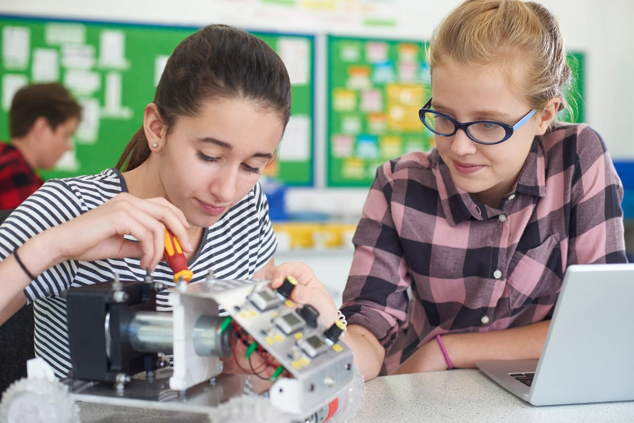
7. Encourage a growth mindset
Girls are more confident, and achieve more, when they have a ‘growth mindset’ about their skills and abilities.
A growth mindset is about believing that success is due to your own effort and persistence, rather than natural ability.
Image credit: Ian Allenden/Dreamstime.com
Notes:
There is no evidence that boys have more natural ability in STEM than girls.
Boys tend to attribute success to their own efforts and failure to external factors. This is called a growth mindset.
Girls tend to do the opposite. They attribute success to natural ability. This is called a fixed mindset.
The idea of growth and fixed mindsets comes from the work of Carol Dweck, who found that girls often have a fixed mindset when it comes to STEM.
This has been attributed to different learning challenges for young boys and girls. Young boys often find it challenging to sit still and complete tasks, so are praised for ‘trying hard’ rather than the quality of the completed task, whereas girls are often more able to focus and complete tasks, so are praised for ‘getting it right’.
You can help by:
discussing growth and fixed mindsets with girls
providing specific, positive feedback on effort, strategies and behaviours rather than attributing success to natural ability.

Slide 18
Activities to try at home
DIY activities
Do an audit of the electrical appliances in your house: are they energy efficient?
Learn Morse code and swap coded messages.
Experiment with the strength of different structures using dried pasta.
Watch a movie that positively portrays women in STEM careers.
Do the Career Quiz on the GiST website.
Notes:
These are just some of the activities you can undertake as a family. There are many more ideas on The GiST website.

Slide 19
thegist.edu.au
Together, we can inspire girls to engage with STEM!
Notes:
Take-home messages
Families are the biggest influencers in girls’ lives when it comes to choosing subjects and careers.
Families can encourage girls’ interest in STEM by:
countering stereotypes
helping girls get hands-on with STEM
connecting STEM with girls’ interests
finding STEM role-models and careers
learning STEM concepts as a family
finding opportunities for creativity and problem-solving
encouraging a growth mindset.

