Slide 1
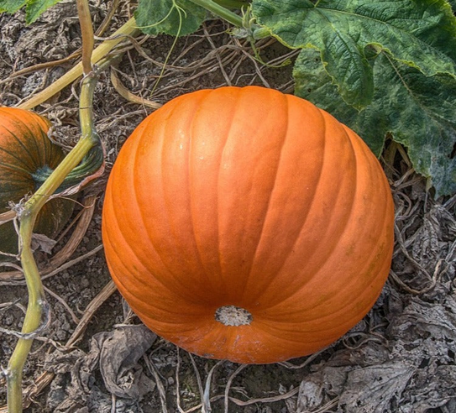
Aitken College
Adele Hudson
Head of Science
Giant pumpkin competition for STEM week

Slide 2
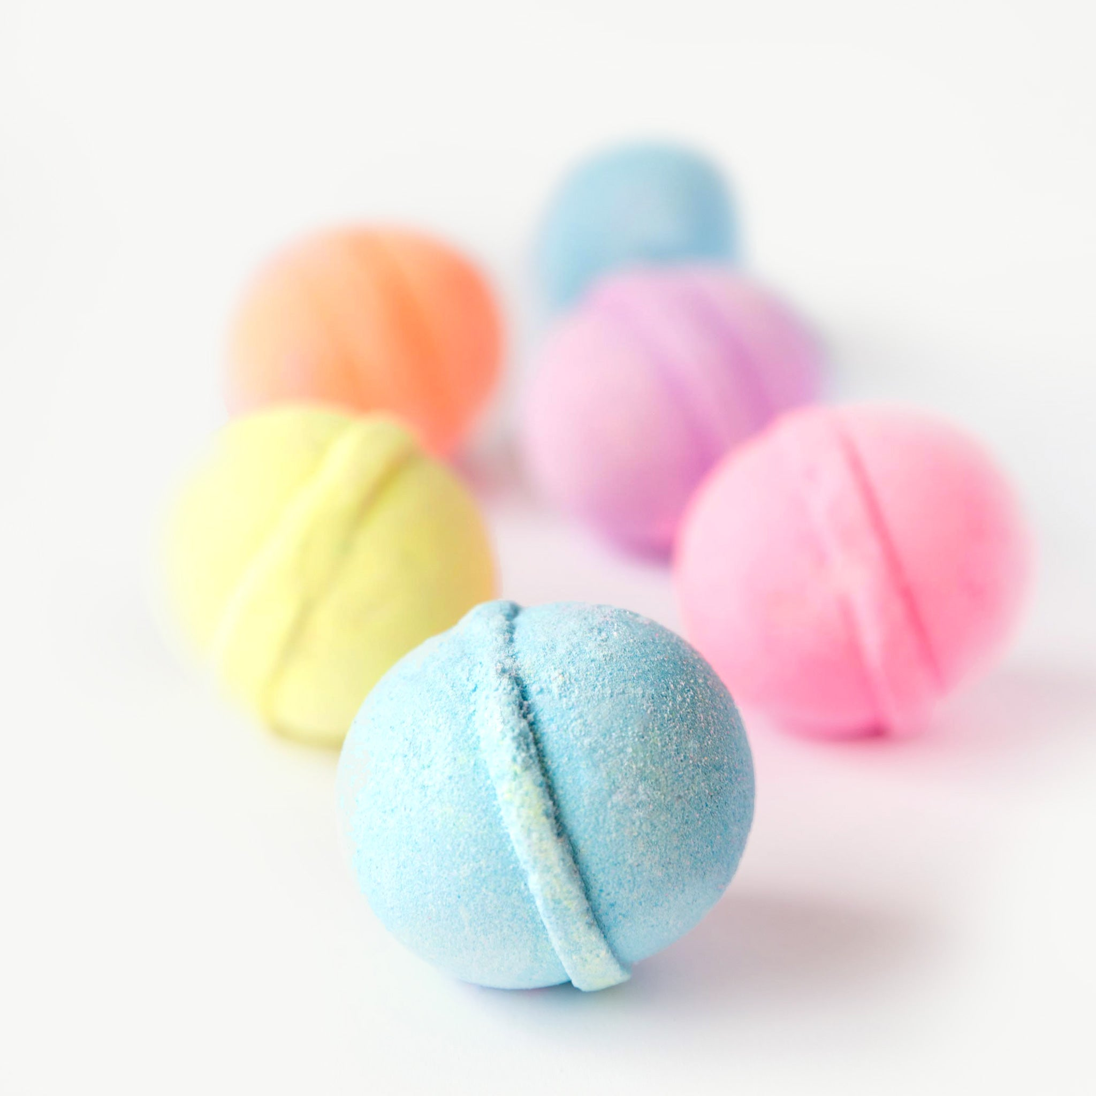
Our background…
Talented and hardworking science teachers
Well attended annual family science event
EngGirls Ecodesign, Bathbomb products for their market

Slide 3
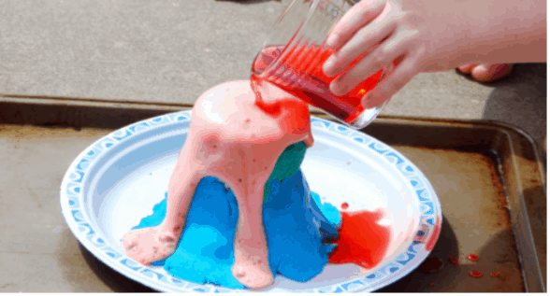
Challenges
Decreasing numbers in VCE Science
Students wanted greater involvement
High teacher workloads
STEM Week, 95 STEM ambassadors ran activities for over 300 participants over a number of STEM Fairs

Slide 4
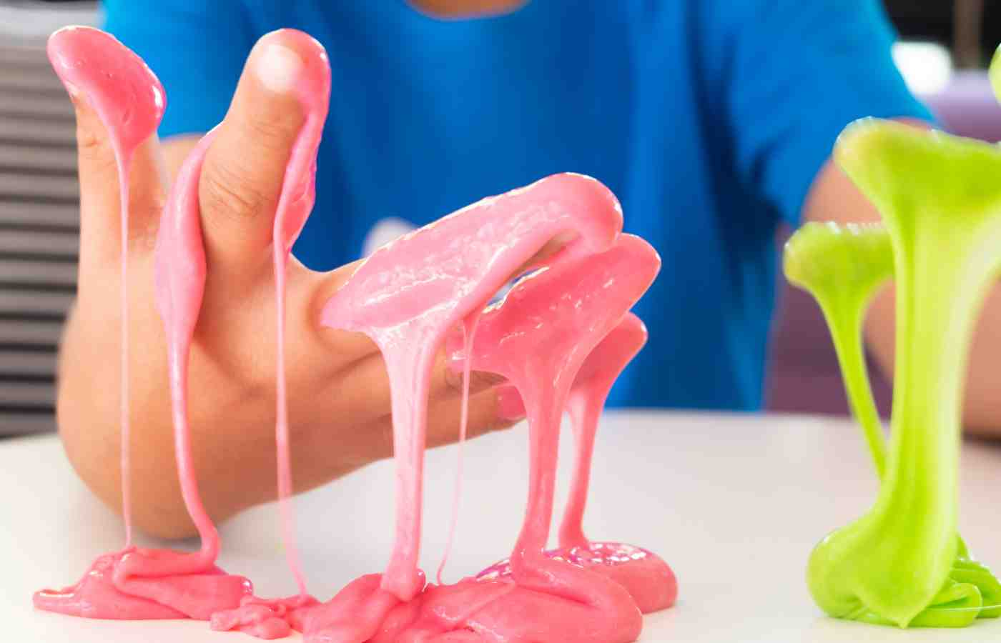
Trialled
Teacher run lunch time demonstrations
Teacher run primary school events
Teacher run lunch time practical sessions
Student enjoying ooblech slime at Family Science Night

Slide 5
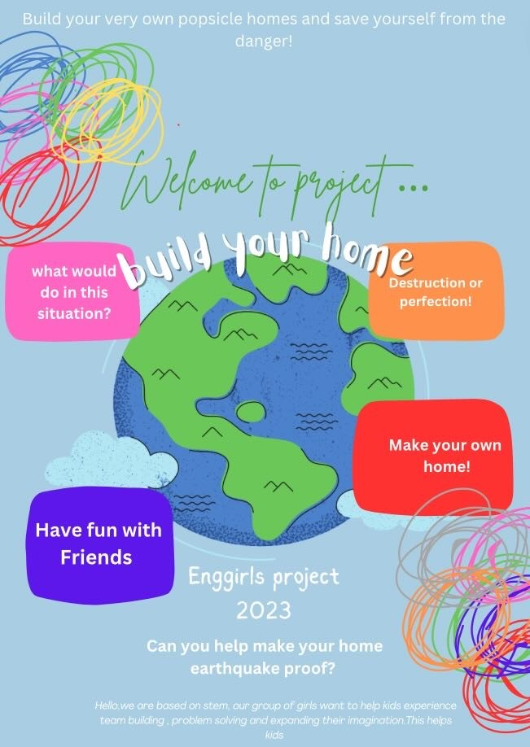
Opportunity knocks
Joint project with Metro Trains to promote STEM careers to girls
Outcome: EngGirls
A program designed by girls in Year 9 to promote the value of STEM to children.
EngGirls STEM workshop, Year 9 student design workshop for primary students

Slide 6
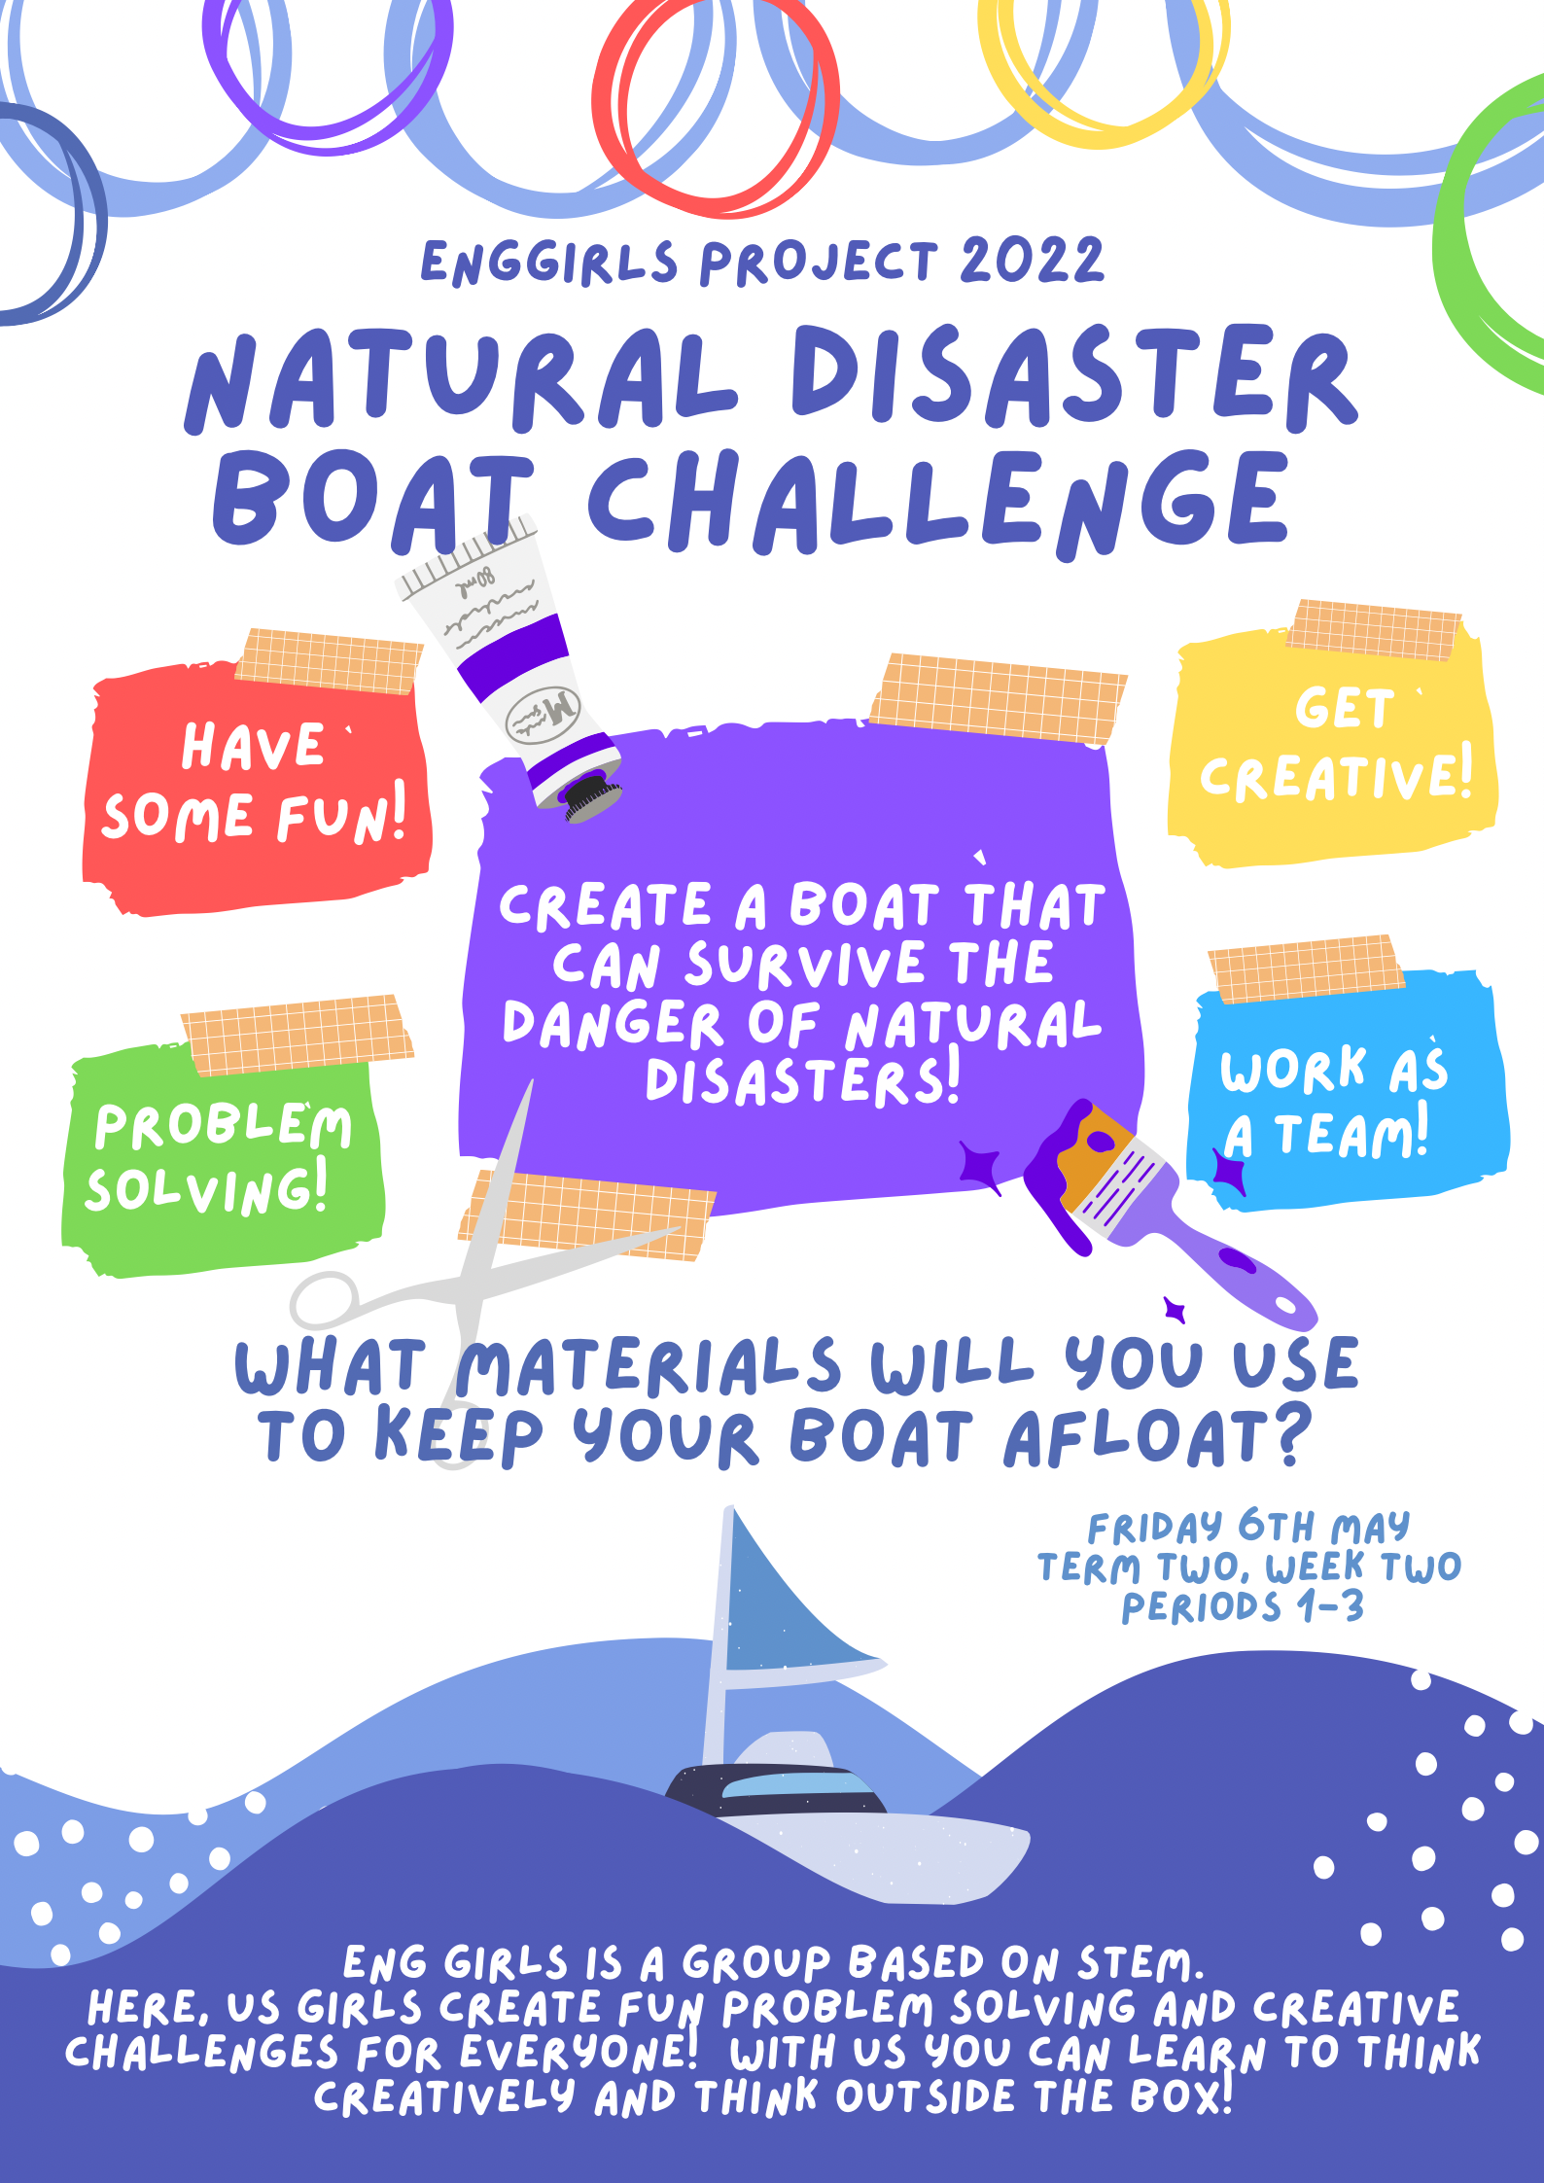
EngGirls highlights
Led by students for students
Short 5 week lunch time program
Low cost in dollars and teacher time
Collaborative
Work towards goal
STEM workshop for primary students

Slide 7
6 years later
More teachers joined the team
Has grown to include other year levels and other ‘pop up clubs’
Won an award – Innovating to help girls to thrive in STEM
Well known brand within school community
Alumni come back to share their experiences at University

Slide 8
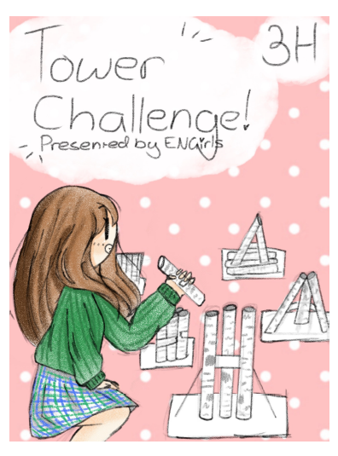
What do the Year 9 EngGirls say?
“Students in Year 9 students should join the EngGirls program because it gives you a lot of opportunities to learn more about team work and it's fun."
"100% do it. It's lots of fun, a great experience, kind of challenging and looks good on your resume."
"Do it, the hard work will pay off when you teach the younger kids and the excursion is a lot of fun.“

Slide 9
What do past EngGirls say?
“I got to know the science teachers more. We had sport, music and theatre outside of class times and I could now do science activities.”
“I learnt skills that I couldn’t learn in class. How to talk with people, how to encourage people to join in.“
“I wouldn’t have chosen so many science subjects without EngGirls and STEM ambassadors. It gave me the confidence to choose subjects like Chemistry which other students said was really hard.”

Slide 10
What are the take home messages?
.
Students value connections to teachers beyond the classroom
Gives students confidence to choose VCE STEM subjects
Students value extracurricular activities
Provides opportunity to learn work skills
Shows students that STEM is fun

