Slide 1

Engineers are problem solvers

Slide 2

Learning hook
Engineers are
problem solvers

Slide 3

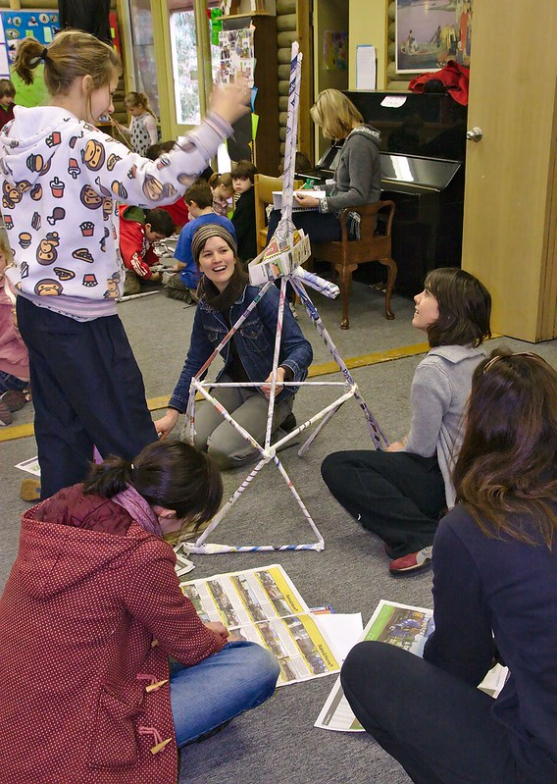
Paper tower challenge
Using just three pieces of scrap A4 paper and masking tape, build the tallest free-standing structure you can.
View all the towers and notice the different ways of solving the problem.
Image credit:
Flickr/ Swee Oon, CC BY-NC 2.0 DEED

Slide 4
Engineers are
problem solvers
Learning input

Slide 5
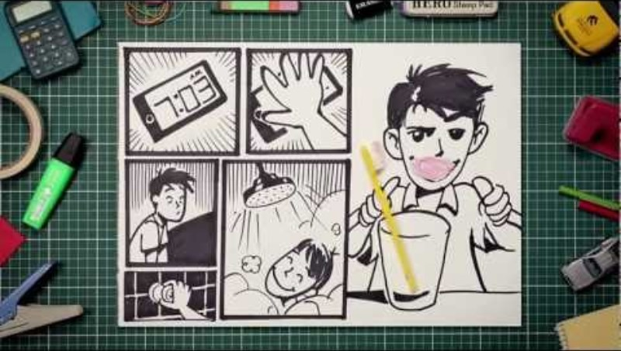
What is engineering?
Source: YouTube/The University of Newcastle

Slide 6


Marita Cheng
Founded the international organisation Robogals.
CEO and Founder of Aubot.
Aubot develops telepresence robots that allow the user to visit, engage with and explore other locations through remote control and video call.
Image credit: Marita Cheng
    Watch this video to learn more about Marita’s passion for robotics.

Slide 7
Engineers are
problem solvers
Learning
construction

Slide 8
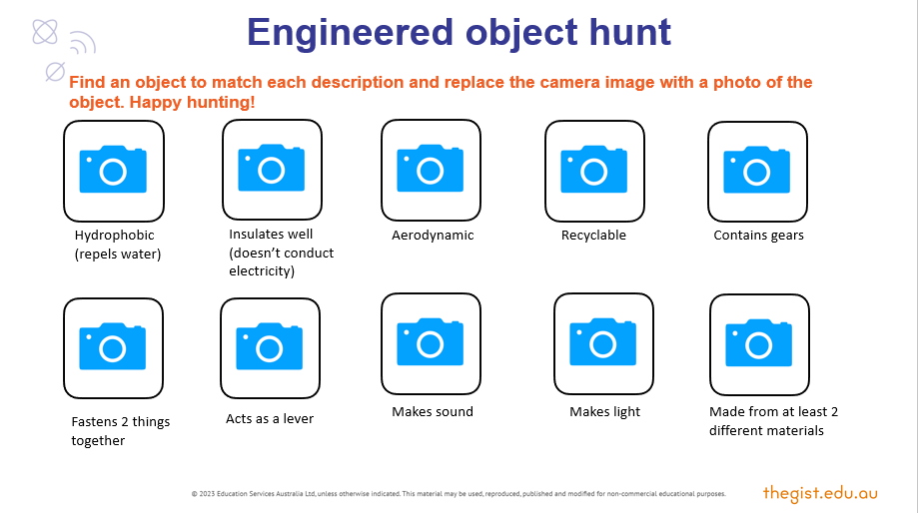
Try this – Engineered object hunt
Complete an engineered object scavenger hunt around your school.
Snap photos of objects that match the descriptions.

Slide 9
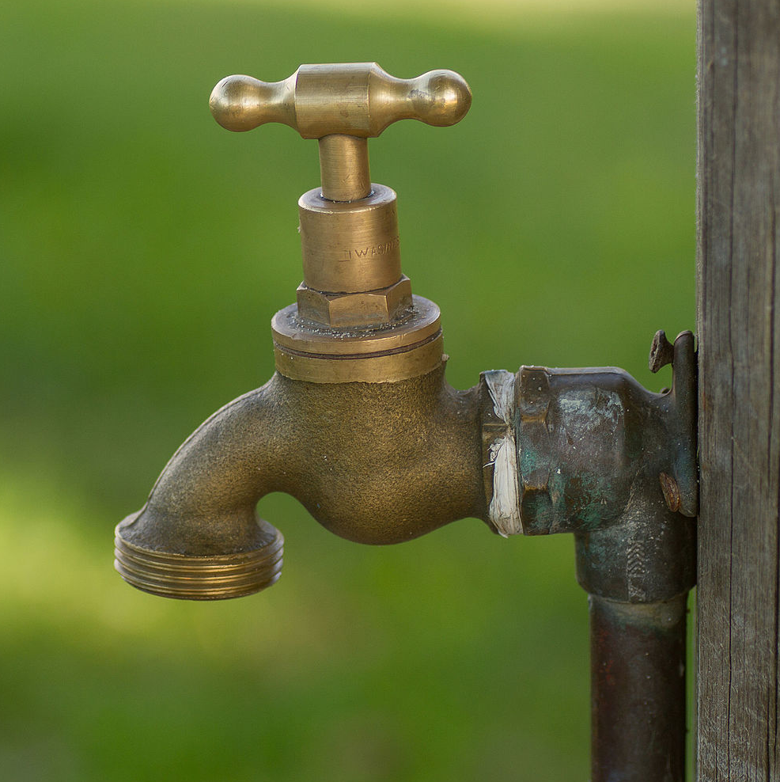

Engineered objects solve problems
Image credit: Wikimedia Commons/Maksym Kozlenko, CC BY SA
Image credit: Wikimedia Commons/Niki Odolphie, CC BY
Releases water in a predictable stream
Can be turned off or on
Doesn’t leak
Can have a hose screwed to it
Holds liquids
Stops your hands from getting hot
Smooth against your lips
Easy to clean
Notes:
Tap image: https://commons.wikimedia.org/wiki/File:Brass_water_tap_in_park.jpg
Cup image: https://commons.wikimedia.org/wiki/File:Used_coffee_mug_%284356081928%29.jpg

Slide 10
Try this – Create an object/use puzzle
List items and the problems they solve.
Write the problem on a piece of paper and the object on another piece.
Challenge a partner to match the objects and their uses.
Object | Problem it solves
Paper book | A light-weight way to record ideas and transport them.
Watch | An easily transportable way to tell what time it is.
Door | A way to let people enter or leave, but shut out noise or weather.

Slide 11
The engineering design process
DEFINE the problem
IDENTIFY constraints
BRAINSTORM solutions
COMMUNICATE
the solution
SELECT the best solution
ITERATE to improve
the prototype
PROTOTYPE the solution
TEST the prototype

Slide 12
Paper tower challenge
Apply the engineering design process to the paper tower challenge.
Using just three pieces of scrap A4 paper and masking tape, build the tallest free-standing structure you can.
Image credit:
Flickr/ Swee Oon, CC BY-NC 2.0 DEED

Slide 13

Paper tower engineering
Document how you followed the engineering design process.
DEFINE
IDENTIFY
SELECT
BRAINSTORM
COMMUNICATE
IERATE 2
PROTOTYPE
TEST
ITERATE 3
ITERATE 1

Slide 14
Rubric
Engineers are
problem solvers

Slide 15
Project Rubric
Criteria | Beginning | Achieved | Exceeded
Brainstorming | Identified a single solution to the problem. | Identified several solutions to the problem. | Identified several solutions to the problem that approached the problem in quite different ways.
Prototyping | Built a prototype. | Built a prototype that showed some similarities to the planned solution. | Built a prototype that used the core principles of the planned solution.
Testing | Measured the height of the tower. | Selected units of measurement to obtain an accurate height. | Selected units of measurement to obtain an accurate height and considered fairness and repeatability when measuring.
Iterating | Built another prototype. | Demonstrated reflection and consideration before and between development of further iterations. | Demonstrated careful evaluation of the first prototype and actioned areas for improvement in development of further iterations.
Group work | Participated in the group discussion and activity. | Participated in discussion and was hands-on in each phase of the engineering design cycle. | Participated and supported others’ participation in discussion and hands-on aspects of each phase of the engineering design cycle.

