Slide 1
Drone search
Years 7 – 8 lesson
Notes:
Image: https://images.pexels.com/photos/442587/pexels-photo-442587.jpeg?auto=compress&cs=tinysrgb&dpr=2&h=750&w=1260

Slide 2
When?
Where?
What?
Notes:
Honoré Daumier, "Nadar élevant la Photographie à la hauteur de l'Art" (Nadar elevating Photography to Art), published in Le Boulevard, May 25, 1862.
Image from https://en.wikipedia.org/wiki/Aerial_photography - no known copyright

Slide 3
Challenge
Get your pilot’s license
Master aerial photography
Design a new application for drone aerial photography

Slide 4
Milestone 1
Take a ‘dronie’ - a selfie using a drone.

Slide 5
Milestone 2
Use drone aerial photography to explore and map a model landscape.

Slide 6
Milestone 3
Apply drone aerial photography to solve a problem.

Slide 7
Part A: Explore drone applications

Slide 8
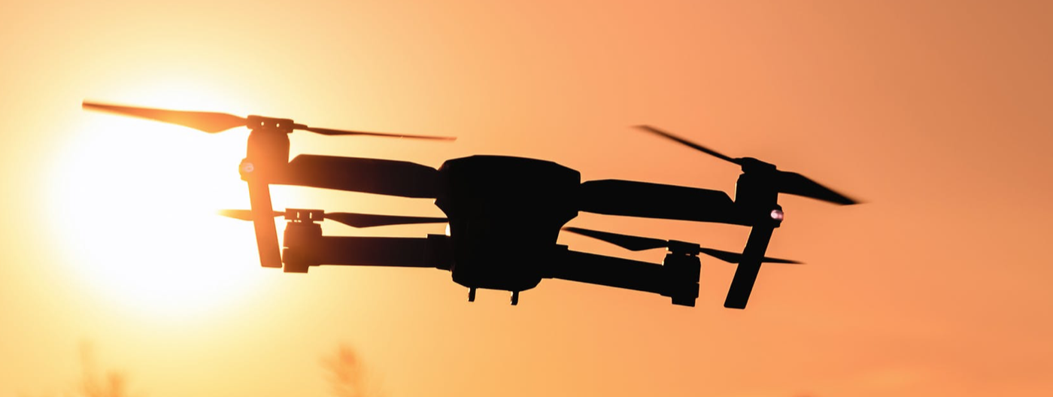
Real estate &
construction
Surveillance
Documentary &
filmmaking
Storm tracking
Drone + Camera
Humanitarian &
disaster relief
Oil, gas & mineral
exploration
Crop growth
monitoring
Energy
infrastructure
inspection
Wildlife population
monitoring
Notes:
image: as per cover image
icons: Apple Keynote shapes

Slide 9
Using fleets of drones to cooperatively explore terrain under thick forest canopies
- MIT
Notes:
https://www.youtube.com/watch?v=2hRNx_0SWGw&feature=youtu.be
http://news.mit.edu/2018/fleets-drones-help-searches-lost-hikers-1102
image: https://commons.wikimedia.org/wiki/File:Creek_and_old-growth_forest-Larch_Mountain.jpg

Slide 10
Identifying earthquake damage
- Tamarah King, earthquake geologist
Notes:
Tamarah King, Earthquake Geologist
https://australiascience.tv/vod/tamarah-king-earthquake-geologist/
http://rockheadsciences.com/king-earthquake-geology/
Image: request to use required: https://i2.wp.com/rockheadsciences.com/wp-content/uploads/2018/07/IMG_2775.jpg (copyright owned by Tamarah King)

Slide 11
Using drones to collect high resolution aerial imagery to inform environmental and social decision-making
- Open Reef
Notes:
http://www.citizensciencegis.org/projects/open-reef/
A citizen science mapping project between the University of Central Florida, University of Belize, and the Coast Zone Management Authority and Institute
Image link: https://commons.wikimedia.org/wiki/File:Caye_Caulker_Belize_drone_(20255979023).jpg
Associated poster: Christine Munusteri, Solutions Engineer https://kartrausers.s3.amazonaws.com/myacademy/2241832_1539466772749SM_Poster_series_Christine_Munisteri.pdf

Slide 12
Surveying marine litter using drone technology.
- The Plastic Tide
Marine Litter DRONET
Notes:
https://www.theplastictide.com/blog-1/2018/4/22/launching-the-marine-litter-dronet
Image: https://www.theplastictide.com/blog-1/2018/4/22/launching-the-marine-litter-dronet (need to check copyright)

Slide 13
Monitoring leopard seals in Antarctica.
- National Oceanic and Atmospheric Administration (NOAA)
Notes:
Image credit: J Hinke NOAA (https://australiascience.tv/arial-drone-photos-used-in-antarctica-to-monitor-leopard-seals/)
Article: https://australiascience.tv/arial-drone-photos-used-in-antarctica-to-monitor-leopard-seals/
Video: Measuring Leopard Seals with Drones https://www.youtube.com/watch?v=6shmhPkP5aI

Slide 14
Part B: Design a drone application
Notes:
In order to demonstrate how the drone photography application will work, students build an appropriate 2m x 2m landscape model and show how their drone will collect data.
Students use drone and other device photography to capture data and drone action for their report.
Extension: Students can code their drone to survey the landscape and collect photo data.

Slide 15
Consider:
What’s the problem?
What are the current solutions/methods?
Why is drone photography a good solution?

Slide 16
Part C: Create a model
Notes:
In order to demonstrate how the drone photography application will work, students build an appropriate 2m x 2m landscape model and show how their drone will collect data.
Students use drone and other device photography to capture data and drone action for their report.
Extension: Students can code their drone to survey the landscape and collect photo data.

Slide 17
Part D: Present your findings
Notes:
Students present their findings as a poster, report, presentation or short movie.

