Slide 1
Sandcastle ratios

Slide 2
Sandcastle ratios
Learning hook

Slide 3
The world’s tallest sandcastle
Notes:
Enable content to view the video
https://www.youtube.com/shorts/H39huVYHiG8

Slide 4
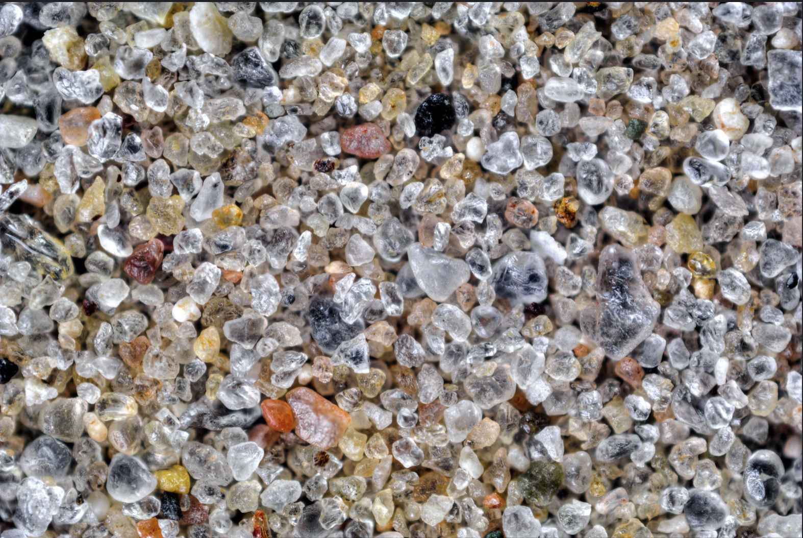
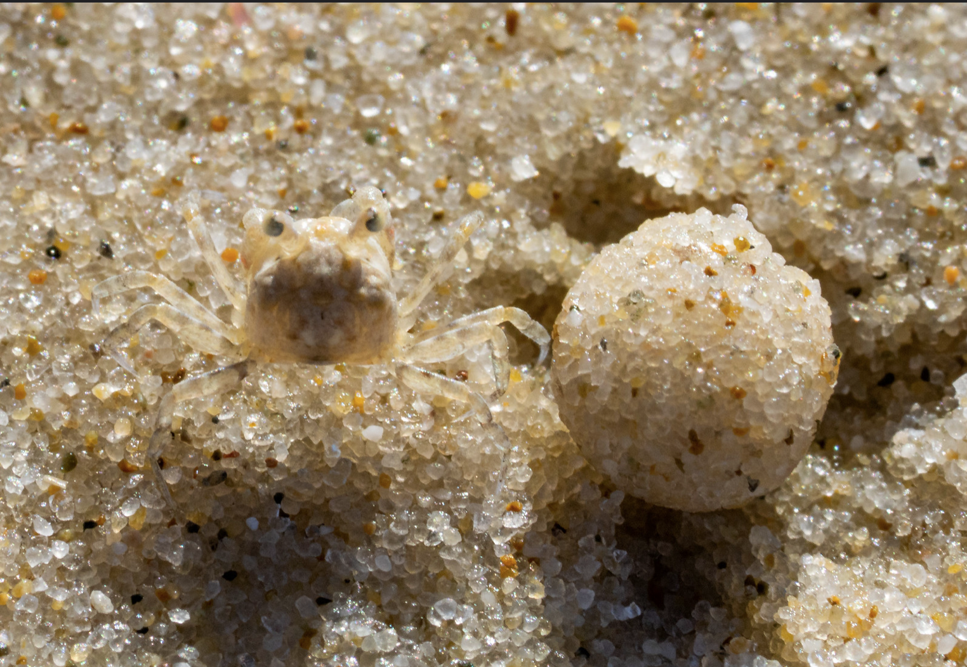
Different types of sand
Sand has different properties depending on what it is made of and where it is found:
grain composition
grain size/s
grain shape/s.
Sand and sand bubbler crab, Flickr/John Turnball, CC BY-NC-SA
River sand, Flickr/oldTor, CC BY-ND-ND
Notes:
Images: River sand https://www.flickr.com/photos/oldtor/46874002704/in/photostream/
Crab with sand https://www.flickr.com/photos/johnwturnbull/51245228564

Slide 5
View sand under the microscope
Notes:
Source: https://www.youtube.com/watch?v=YX7aS1KheWE&t=2s

Slide 6
Mariny Chheang
Worked with Engineers Without Borders Australia to provide clean water to the Koh Tnoat community in Cambodia.
Designed a solar-powered sand filtration solution inspired by the traditional water purification techniques the community had used for millennia.
Read this article to learn more about Mariny’s career and her work with Engineers Without Borders Australia.
Notes:
Mar

Slide 7
Sandcastle ratios
Learning input

Slide 8
Try this
Collect different samples from around the school or local environment.
Observe each sample using a magnifying glass or microscope.
Represent your findings.
?
Where do you think each sample originated? Why?

Slide 9
Sandcastle ratios
Learning
construction

Slide 10
Which sand will be strongest?
Sand A
Sand B
Sand C

Slide 11
How can you test the best ratio of sand to water?
Beaker
Coffee cup
Dry sand
Weights
Flat plate/board
?
What variables will you need to control? How will you design your experiment?

Slide 12
Working with ratios – how tall can you go?
Scale using the sand-to-water ratio to prepare the building sand.
Work out if there’s a radius-to-height ratio that can predict the base size needed to build a conical sandcastle of a certain height.

Slide 13
Building techniques
Notes:
Source: https://www.youtube.com/watch?v=_06qg0Zis9c

Slide 14
Apply your arenological skills!
Sketch your design.
Plan the materials required.
Consider constraints.
Adjust your plan.
Get building!
Photograph your final castle.

Slide 15
Sandcastle ratios
Rubric

Slide 16
Project Rubric
Criteria | Beginning | Achieved | Exceeded
Investigation method | The method identifies and controls some variables. | The method identifies and controls variables to ensure a fair test. | The method identifies and controls variables and considers best equipment to reduce measurement error.
Investigation findings | Data is represented in a table. A ratio is identified. | Data is represented in a clear table and trends are identified. A final best ratio is identified. | Data is represented in a clear table. Trends and possible errors are identified. A final best ratio is identified and justified.
Investigation report | The report includes key information. | The report provides enough detail for the method to be reproduced and results compared. | The report provides enough detail for the reader to understand the limitations of the experiment and assess the reasonableness of the findings.
Design process story | Sketches and photos show the process of building the sandcastle. | Sketches and photos show iteration and the evolution of design ideas. | Sketches and photos show iteration, problem-solving and the evolution of design ideas.

