Slide 1
Biomimicry glider

Slide 2
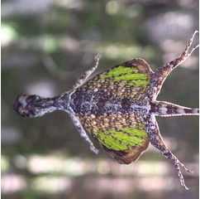
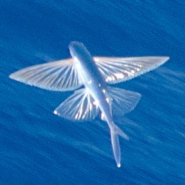
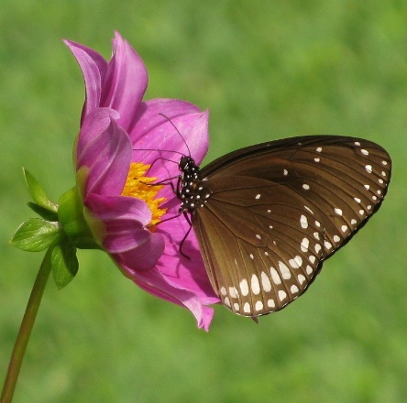
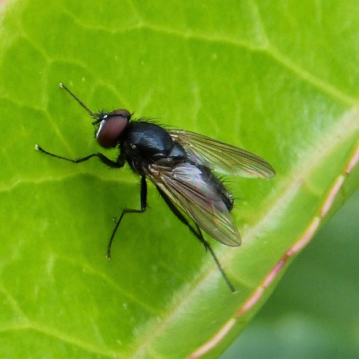
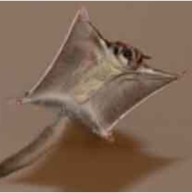
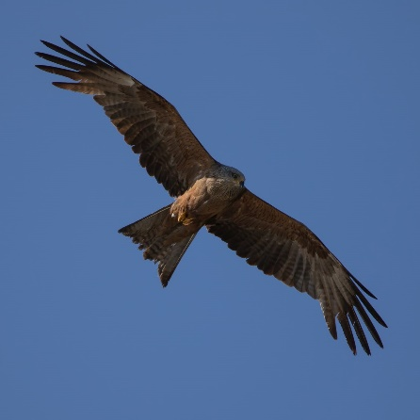
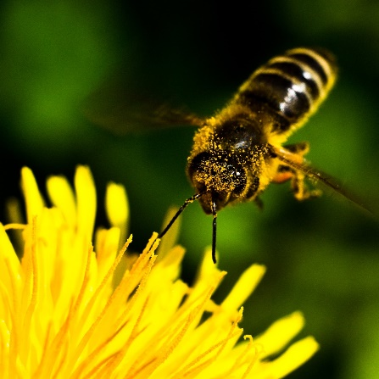
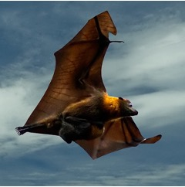
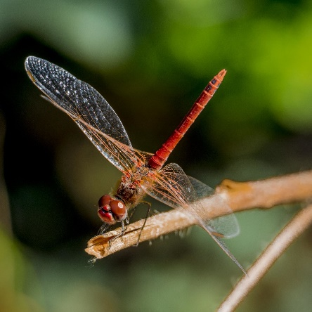
Animals taking flight
?
What do you notice or wonder about these images?
1.Tambuka'ka Flying Lizard, Fickr/Richard Parker, CC BY-ND-SA
2. Flying Fish, Fickr/Theron Trowbridge, CC BY-ND
3. Euploea core Fickr/Ajith Kumar, CC BY
4. Male Hydrotaea species, Fickr/gailhampshire, CC BY
5. sugar gliders, Flickr/Arnold T. Schwartzenglider, CC BY-NC-ND
6. Black kite, Flickr/Antje Schultner, CC BY-SA
7. Bee, Flick/renee.hawk, CC BY-ND
8. Foxbat carrying baby, Flickr/Paul Hocksenar, CC BY-NC-SA
9. Red dragonfly, Flickr/Esin Üstün, CC BY

Slide 3
Wingsuits
?
Which animal does Ellen Brennan most resemble in her wingsuit?

Slide 4
Biomimicry glider
Learning input

Slide 5
Find the glider components
Wings
Fuselage (body)
Tail
Nose
Figaro, Public domain, via Wikimedia Commons
RegiegeigeR, Public Domain, Wikimdia Commons

Slide 6
Try this: Build a basic glider

Slide 7
Biomimicry glider
Learning
construction

Slide 8
Biomimicry
Aerospace engineers often derive inspiration from the natural world.
This is called biomimicry.
Aerospace engineers ask questions such as:
how can we make aircraft wings change shape like birds’ wings?
how can we make planes that fly as silently as an owl?
how can we decrease the weight of the fuselage to mimic flying animals’ light bodies?

Slide 9
Taylah Griffin
Gangalu woman who grew up in Far North Queensland.
Studied Electrical and Aerospace Engineering at QUT.
First indigenous woman to graduate from QUT with an engineering degree.
Watch this video to learn more about Taylah’s journey in aerospace engineering.
Notes:
Mar

Slide 10
Research this
colugo | paradise tree snake | Kuhl’s parachute gecko
flying squirrel | flying fish | Japanese flying squid
draco lizard | Wallace’s flying frog | sugar glider
Create a poster with a labelled diagram showing all the ways the animal is adapted for gliding.

Slide 11
Build a better glider
Engage in biomimicry to iterate on your earlier glider design and improve it so that it can carry a passenger.
Adapt features of gliding animals to improve the design.
Feature | Key considerations | Analogue ideas
Light or hollow bones | Light but strong structural materials | Use paper straws, bamboo skewers?
Streamlined design | Shapes should reduce drag | Could the wings have feather shapes? Should we curve the wing edges?

Slide 12
The engineering design process
DEFINE the problem
IDENTIFY constraints
BRAINSTORM solutions
COMMUNICATE
the solution
SELECT the best solution
ITERATE to improve
the prototype
PROTOTYPE the solution
TEST the prototype

Slide 13
Biomimicry glider
Rubric

Slide 14
Project Rubric
Criteria | Beginning | Achieved | Exceeded
Design notes | Notes demonstrate evidence of brainstorming and at least one iteration. | Notes demonstrate creative brainstorming and multiple iterations to improve the design. | Notes demonstrate creative brainstorming and problem-solving, and there is evidence of multiple iterations that evolve a sound design.
Glider biomimicry | Glider incorporates some biomimicry and is functional. | Glider incorporates biomimicry to meet the distance requirement. | Glider incorporates biomimicry in multiple features to meet the distance requirement.
Glider prototype construction | Prototype uses basic construction techniques. | Prototype uses basic construction techniques with attention to detail. | Prototype uses innovative construction techniques with attention to detail.
Biomimicry poster | Poster explains basic functional biomimicry, for example, the presence of wings. | Poster explains key biomimicry features of the evolved glider design. | Poster explains key biomimicry features, demonstrating attention to detail in the evolved glider design.

