Slide 1
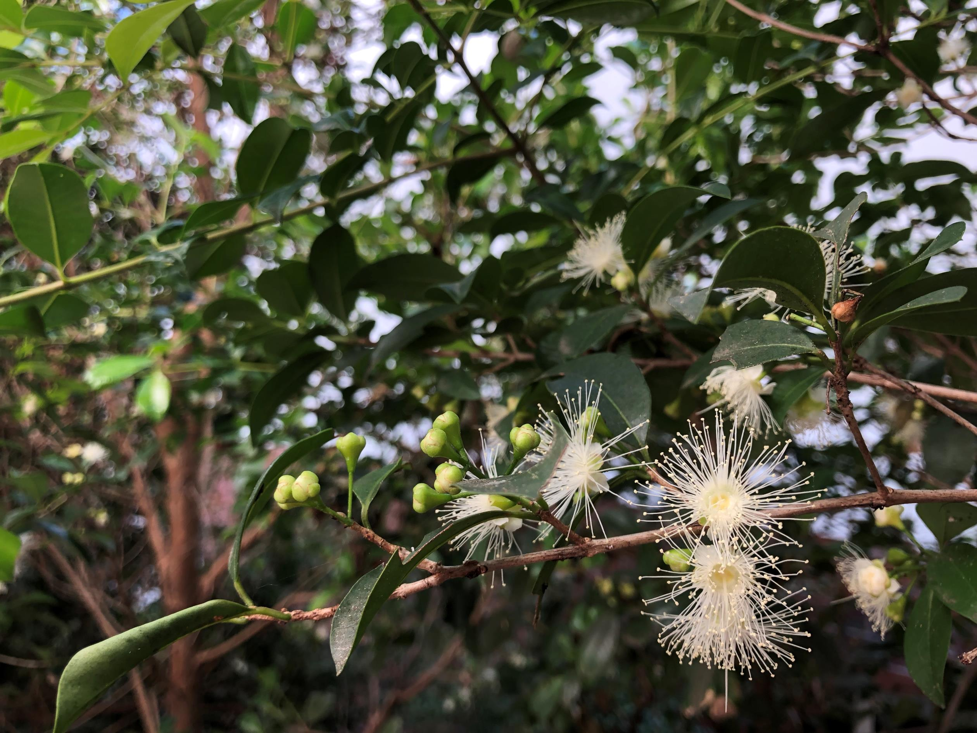
Native bee habitat
Notes:
Image credit: Mel Isaacs (copyright free)

Slide 2
European honey bee (Apis mellifera)
Notes:
Image: https://pixabay.com/photos/honey-bees-beehive-honey-bees-326337/
Free for commercial use; no attribution required.

Slide 3
Quasihesma bee
Notes:
Image: http://www.padil.gov.au/pollinators/pest/main/138841/17545#
Author: Walker, K.
Free for use under the Creative Commons Attribution 3.0 Australia License

Slide 4
Blue banded bee (Amegilla asserta)
Notes:
Image: https://commons.wikimedia.org/wiki/File:Australian_Blue_Banded_Bee-Best_viewed_large.jpg
Author: Louise Docker
Creative Commons Generic License - reuse with attribution and link

Slide 5
Sugarbag bee (Tetragonula carbonaria)
Notes:
Image: https://sco.m.wikipedia.org/wiki/File:Tetragonula_carbonaria_(14521993792).jpg
Author: Graham Wise
Creative Commons Generic License - reuse with attribution and link

Slide 6
Great carpenter bee (Xylocopa species)
Notes:
Image: https://www.flickr.com/photos/usgsbiml/31416596982
Author: Sam Droege
Public domain.

Slide 7
Teddy bear bee (Amegilla species)
Notes:
Image: https://commons.wikimedia.org/wiki/File:Aussiegall_-_Not_you_again_(by).jpg
Author: Louise Docker
Creative Commons Generic license - share with attribution.

Slide 8
Bee anatomy
Notes:
Bee anatomy - from https://askabiologist.asu.edu/honey-bee-anatomy

Slide 9
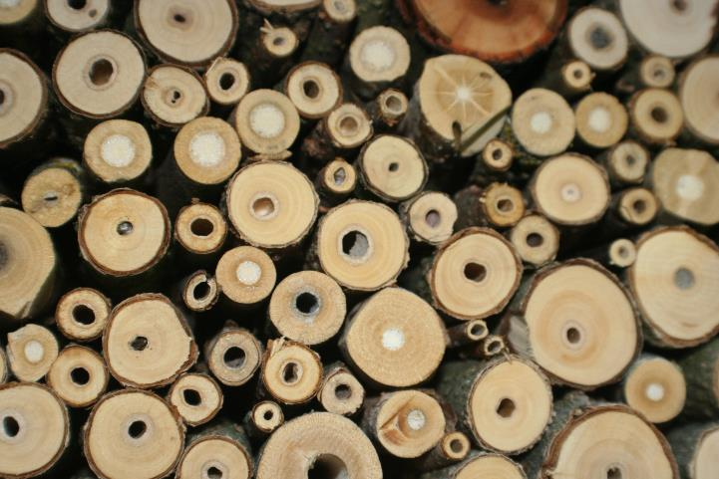
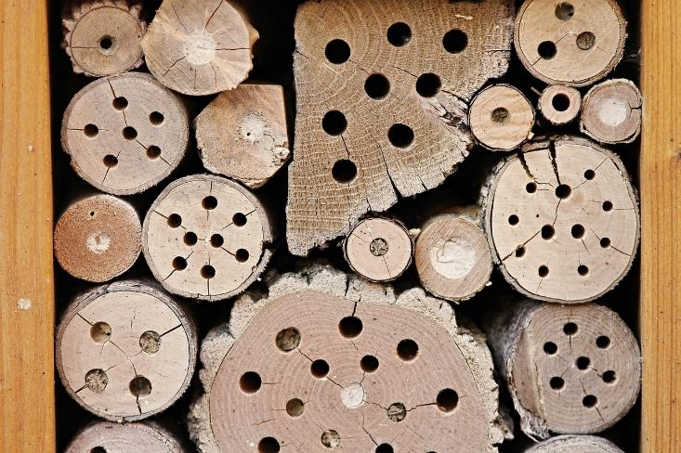
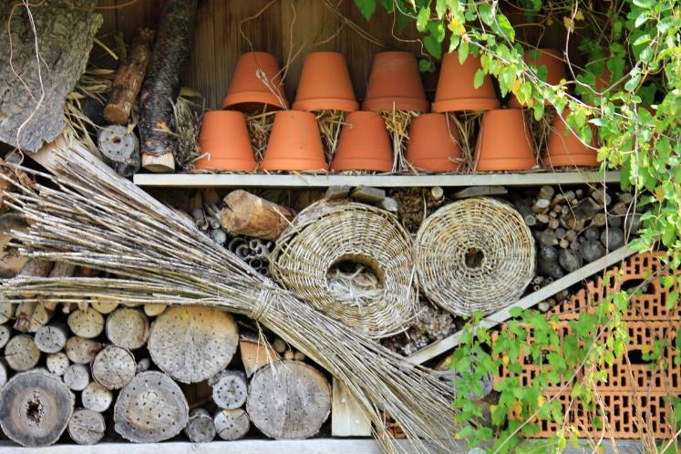
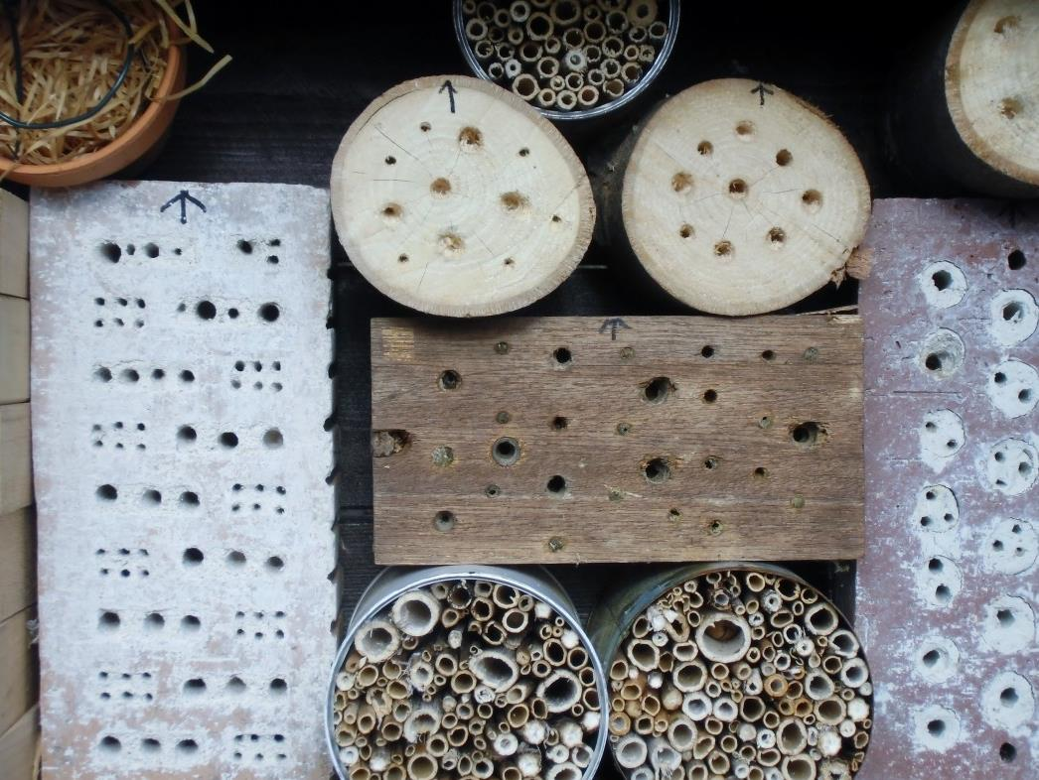
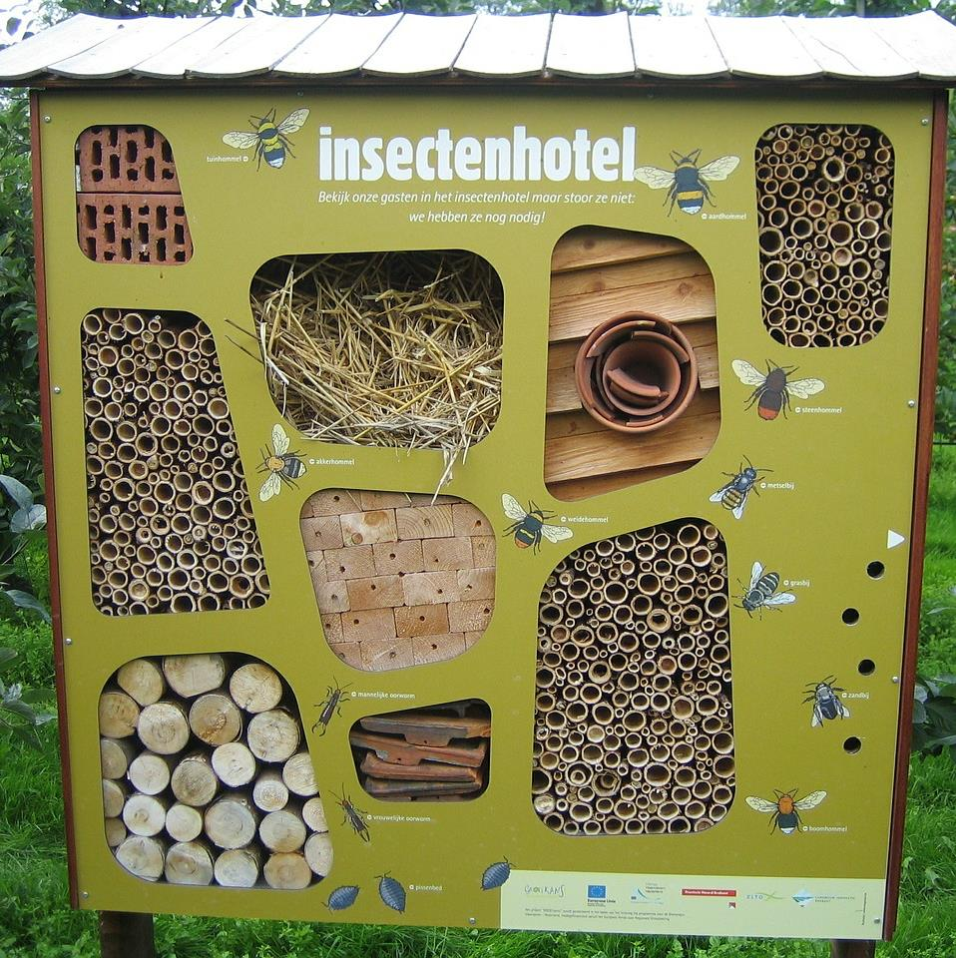
Bee hotel design ideas
Notes:
Images from left to right, top to bottom:
Image 1: https://www.pexels.com/photo/bee-hotel-breeding-help-drill-holes-insect-271351/
Image 2: https://www.maxpixel.net/Shelter-Insect-Hotel-Wood-Perforated-Insect-House-2643713
Image 3: https://pxhere.com/en/photo/1013774
Image 4: https://pxhere.com/en/photo/1344654
Image 5: https://www.maxpixel.net/Insects-Hotel-Nature-Bees-525415

